Slide 1
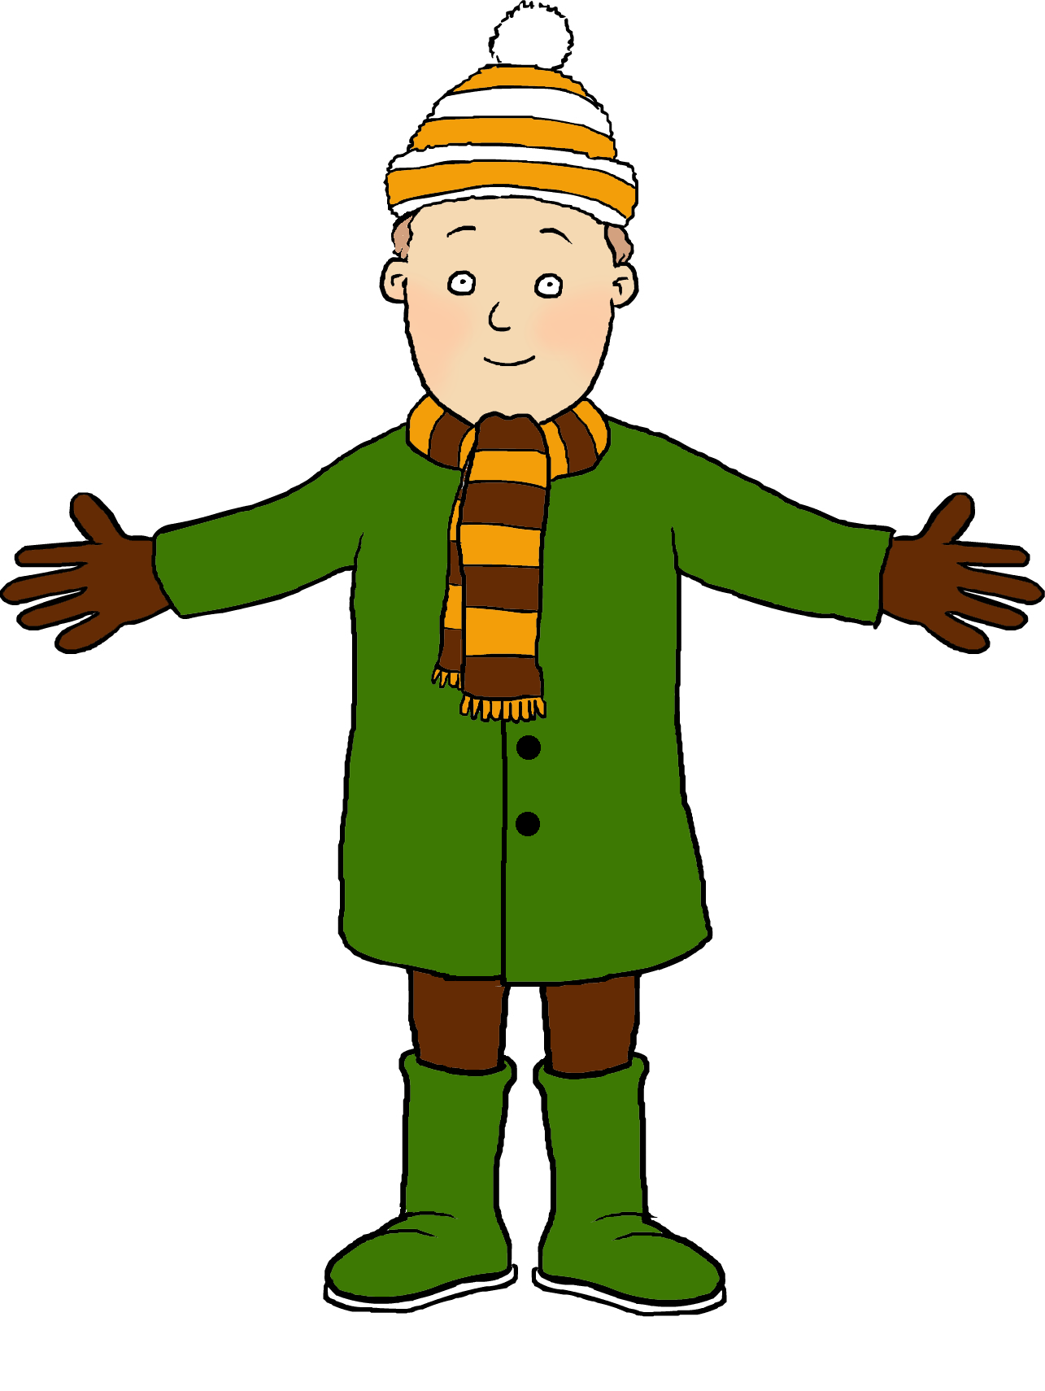
Parts of the body

Slide 2


To learn the names for different parts of the body in French.

Slide 3
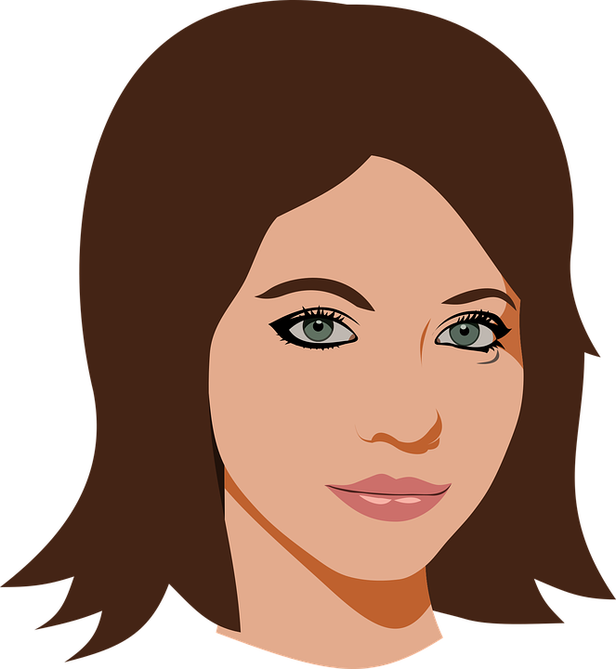



Slide 4


Slide 6


Slide 8
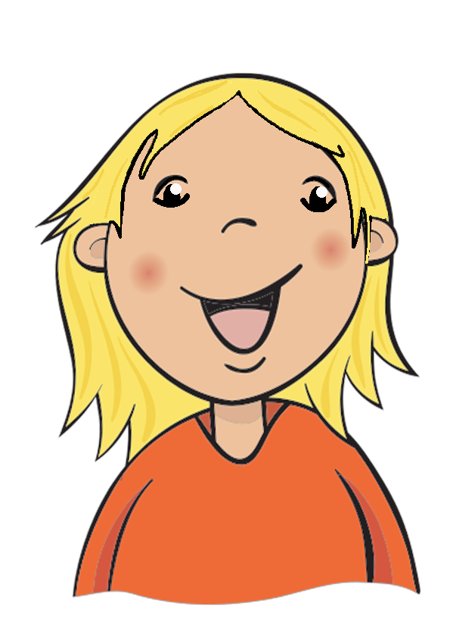

Slide 11
la tête

Slide 12
les épaules

Slide 13
les genoux

Slide 14
les pieds

Slide 15
les yeux

Slide 16
les oreilles

Slide 17
la bouche

Slide 18
le nez

Slide 20





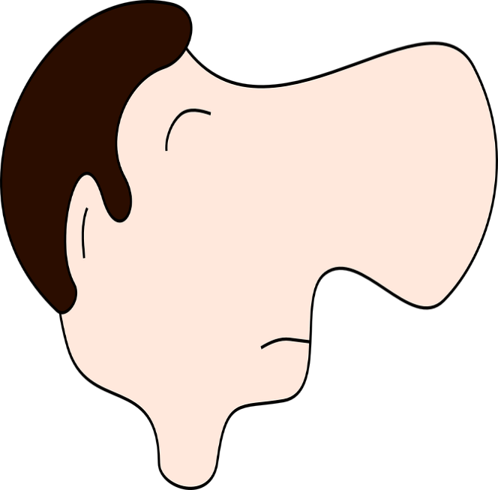


Slide 21

Song for extension activity A

Slide 22
Song for extension activity B

Slide 23
