Slide 1
Using Songs To Teach Spanish
Catherine Barlow
Author of “¡Me Gusta Cantar!” (Songs translated by Delia Alvarez from “J’aime Chanter” and “J’aime Beaucoup Chanter en Français!”) published by Brilliant Publications

Slide 2
Why use songs to teach Spanish?
Who will we use songs with?
What songs will we teach?
How do we teach songs?
How can we exploit songs?
What will our pupils gain from learning songs?

Slide 3
Why use songs to teach Spanish?

Slide 4
To facilitate the learning and memorising of vocabulary and grammar
To enable pupils to pronounce words correctly
To promote cultural awareness and appreciation
To embed Spanish within other areas of the curriculum
Just for fun

Slide 5
Who will we use songs with?

Slide 6
Pupils of all ages and abilities – there are no limits!

Slide 7
What songs
will we teach?

Slide 8
Songs set to familiar tunes – enable teachers and pupils to focus on lyrics
Action songs – memory-joggers
Repetition songs/raps – pupils can copy clearly pronounced lyrics
Songs made up of lists – aid vocabulary retention
Traditional Spanish songs – help pupils develop understanding of Spanish culture
Seasonal songs – Christmas, harvest festival etc

Slide 9
How do we teach songs?

Slide 10
Use existing version of song (CD/You Tube etc) or be prepared to sing a solo!
Allow pupils to listen at least once or twice without joining in
Keep it simple – not too many lyrics
Go over meaning of lyrics/vocabulary – are pupils already familiar with these?
Small sections – repeat words several times
Pronunciation – check pupils copy model carefully
Highlight rhyming words/sound patterns etc
Don’t necessarily show words – it can sometimes hinder pronunciation
Encouragement – some pupils are more reluctant singers – let them join in when they’re ready

Slide 11
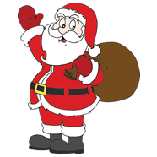
Papá Noel
(Sing to tune of ‘Frère Jacques’)
Papá Noel,
Papá Noel.
¡No traigas carbón!
¡No traigas carbón!
¡Trae regalos para todos!
¡Trae regalos para todos!
Por favor,
por favor.

Slide 12
How can we exploit the songs?

Slide 13
Phonics – listen and look for sounds/rhymes/cognates
Comprehension – listen for specific vocabulary
Sequencing – pupils put words/pictures/symbols in order as hear them mentioned
Role play – build conversations around a song
Composition – make up extra verses
Festivals/cultural events – incorporate songs into whole school/cross-curricular activities eg assemblies, Spanish Day
Grammar – change structures eg parts of verbs
Cloze tasks – written tasks requiring pupils to insert missing words
Just for fun – to round off a topic

Slide 14
What will our pupils gain from learning songs?

Slide 15
Increased confidence in use of the language
Improved pronunciation
Greater understanding of vocabulary and/or grammatical structures
Awareness of Spanish culture

Slide 16
Medios de transporte
(Sing to the tune of ‘The wheels on the bus’)

Slide 17
Voy a Madrid en un avión
Un avión, un avión
Voy a Madrid en un avión
todo el día

Slide 18
Voy a Madrid en un coche
Un coche, un coche
Voy a Madrid en un coche
todo el día

Slide 19
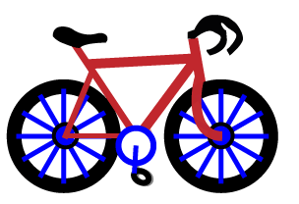
Voy a Madrid en una bici
Una bici, una bici
Voy a Madrid en una bici
todo el día

Slide 20
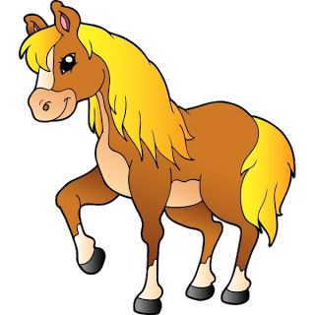
Voy a Madrid a caballo
A caballo, a caballo
Voy a Madrid a caballo
todo el día

Slide 21
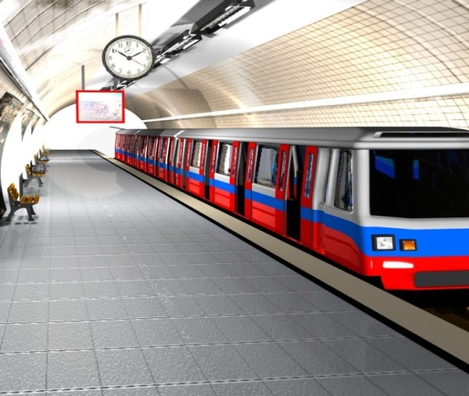
Voy a Madrid en el metro
El metro, el metro
Voy a Madrid en el metro
todo el día

Slide 22
Voy a Madrid en un barco
Un barco, un barco
Voy a Madrid en un barco todo el día

Slide 23
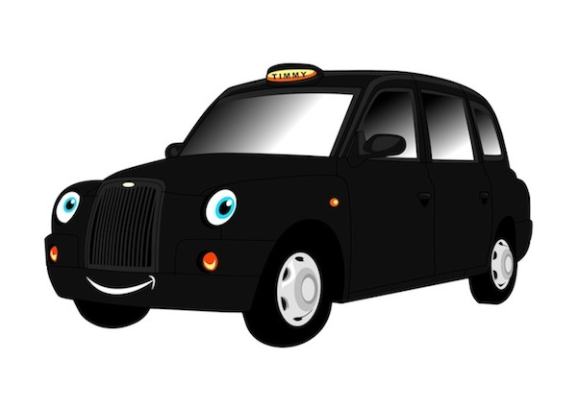
Voy a Madrid en un taxi
Un taxi, un taxi
Voy a Madrid en un taxi todo el día

Slide 24
Voy a Madrid en un cohete
Un cohete, un cohete
Voy a Madrid en un cohete todo el día

Slide 25
Keep it simple!
Make it memorable!
Have fun!

