Slide 1
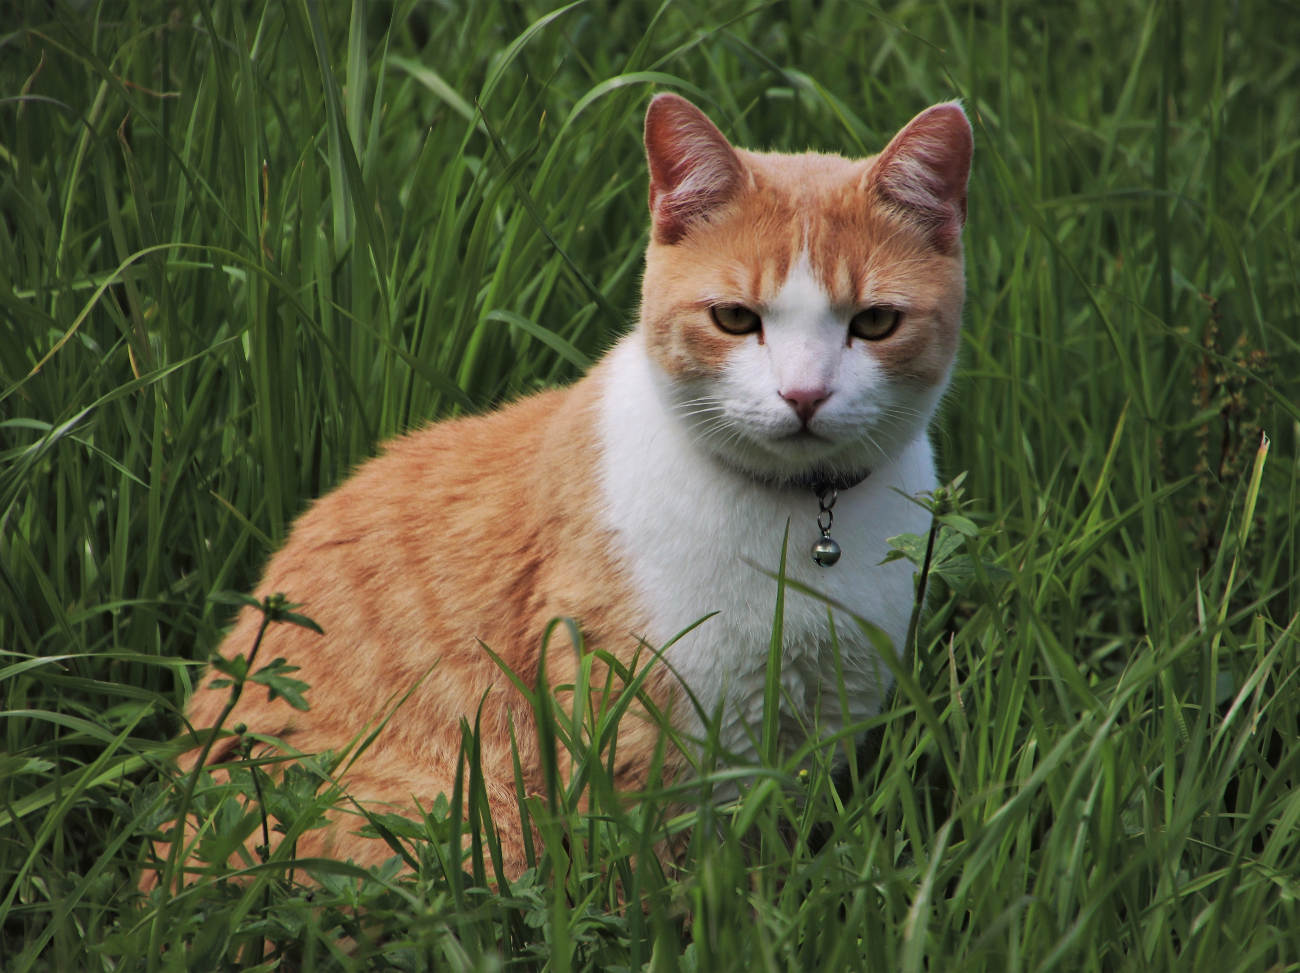
Seven left
LO: I can describe a character and say what motivates them
Who is this cat?
Why has she only got 7 out of her 9 lives left?

