Slide 1
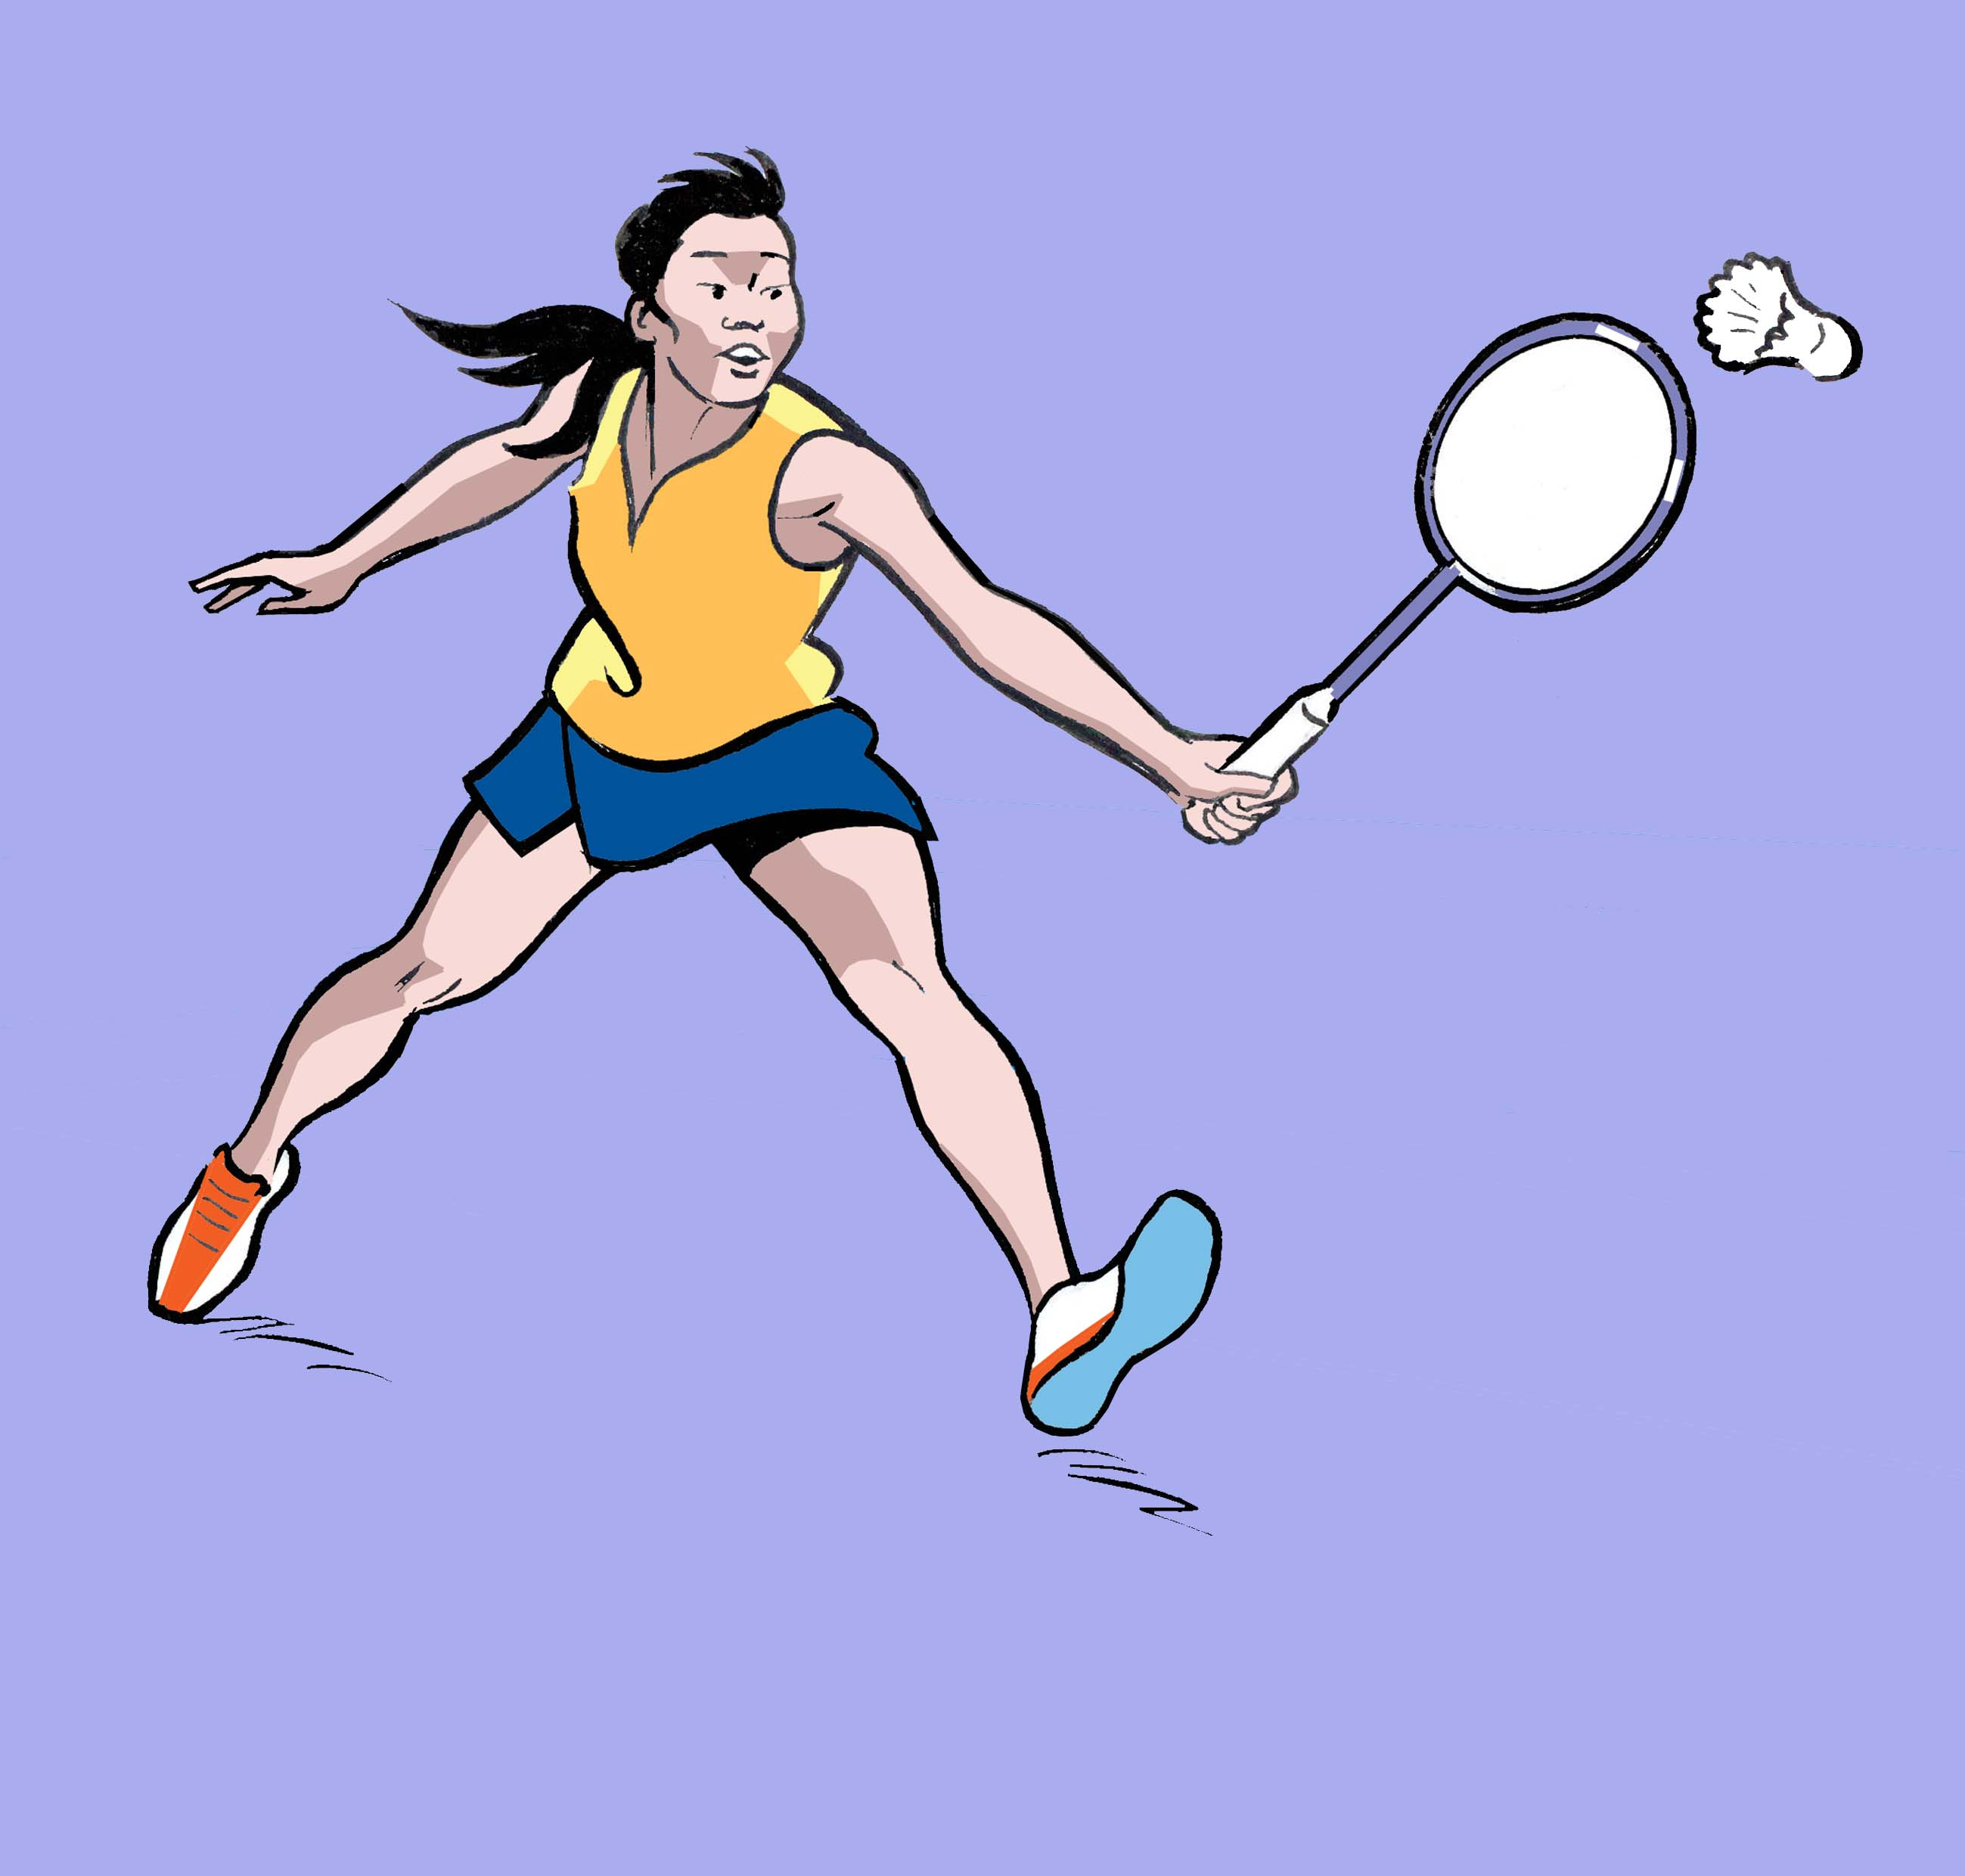
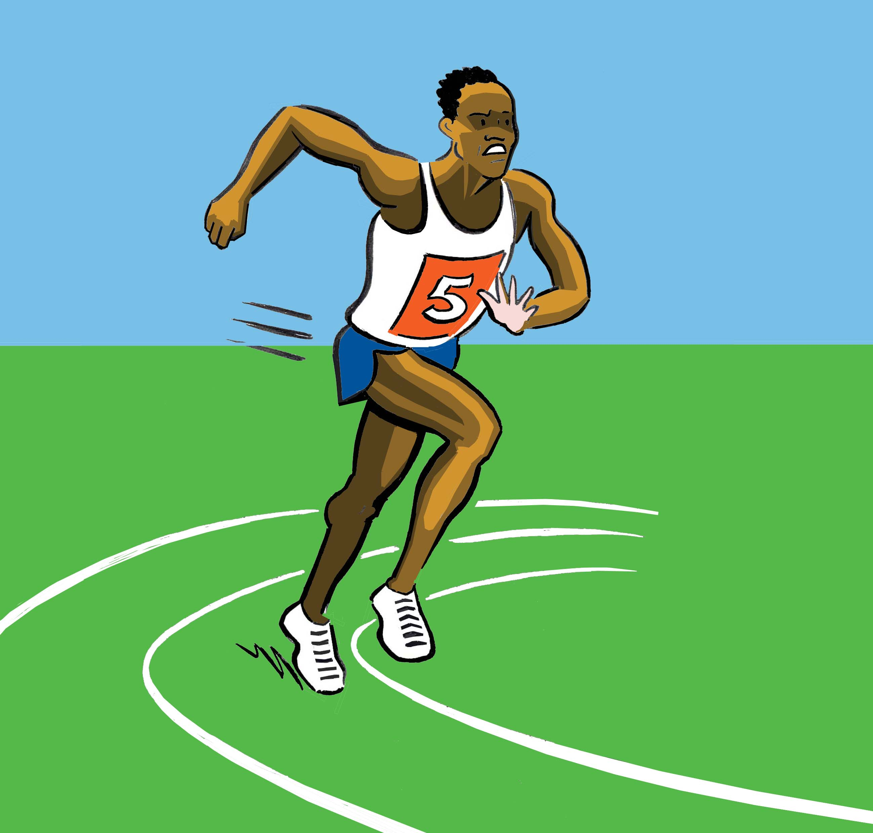
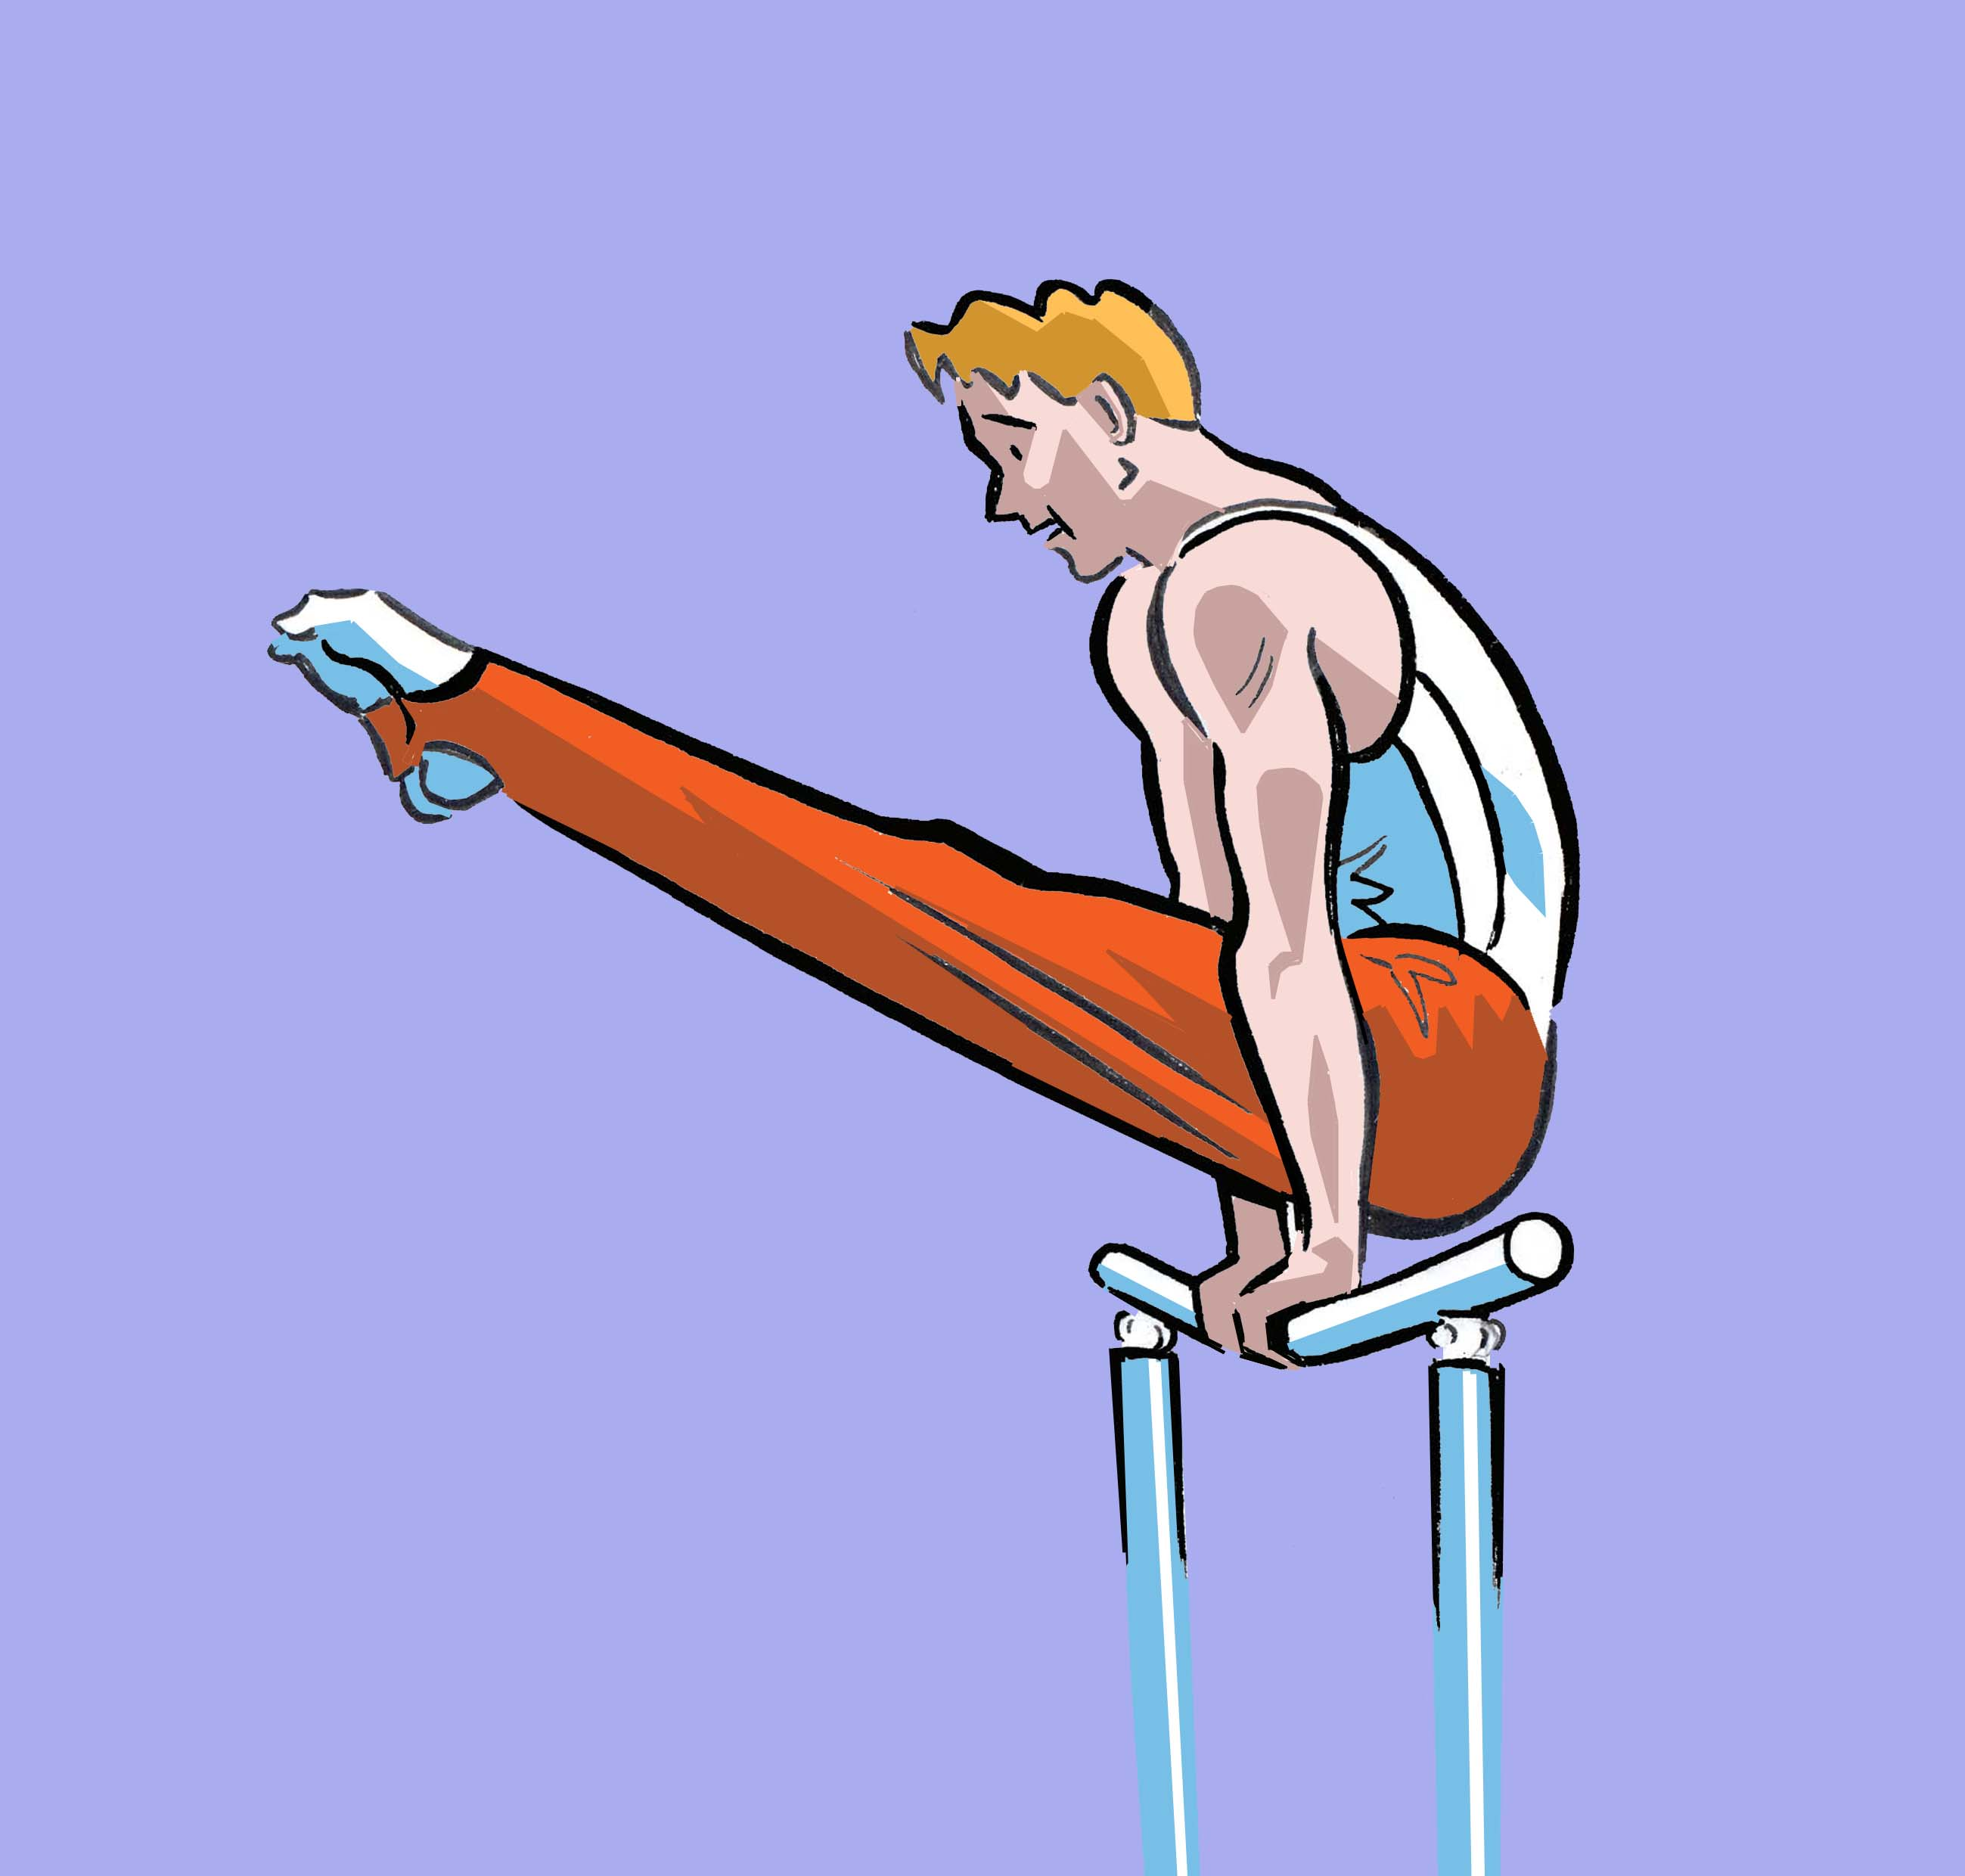
Les 32 Sports Olympiques
French words for the 32 sports at the 2024 Paris Olympics
le badminton
l’athlétisme
la gymnastique

Slide 2
France at the Olympics
French people refer to the Olympics as ‘les Jeux Olympiques’ (the Olympic Games) or simply as ‘les J.O.’
France has participated in all the Olympics of the modern era. However, at the 1904 Olympics which were held in St Louis in the United States, there was only one French athlete. (In fact, some people say he was actually representing the United States and not France.

Slide 3
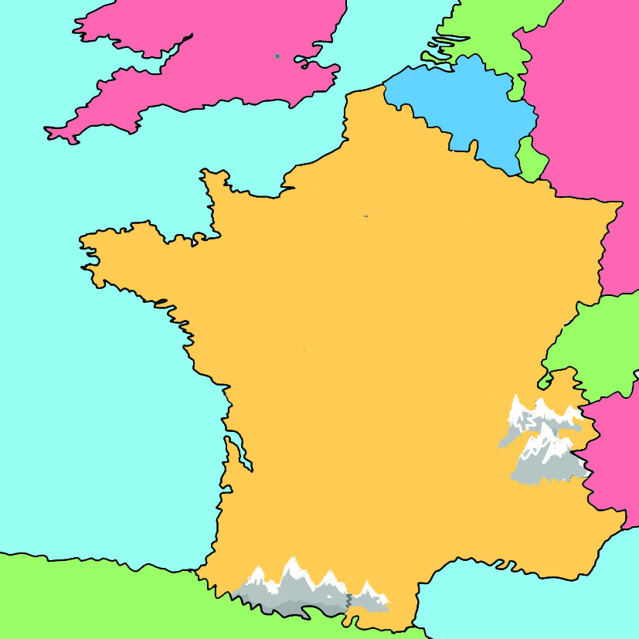
Olympics held in France
France will be hosting the Summer Olympics in 2024 in Paris. France has hosted the Summer Olympics twice before, in 1900 and 1924, both times in Paris.
France has hosted the Winter Olympics three times. In 1924 they were held in Chamonix. In 1968 they were held in Grenoble and in 1992 they were held in Albertville.
Paris
Chamonix
Albertville
Grenoble

Slide 4
French Olympic medals
French athletes have won a total of 751 medals at the Summer Olympics and a further 138 at the Winter Olympics. Over a third of France’s medals at the Winter Olympics have been for alpine skiing.
In the Summer Olympics the most successful sports have been fencing, with 123 medals, followed by cycling, with 93 medals.

Slide 5
France at the Paralympics
France participated in the first international Paralympic Games, which were held in 1960 in Rome. French athletes have taken part in every Summer and Winter Paralympics since then.
France hosted the 1992 Winter Paralympics.
French athletes have been very successful at the Paralympic Games, winning a total of 1091 medals at the Summer Paralympics and 183 at the Winter Paralympics.

Slide 6
Les 32 Sports Olympiques
Blue = masculine word
Red = feminine word

Slide 7
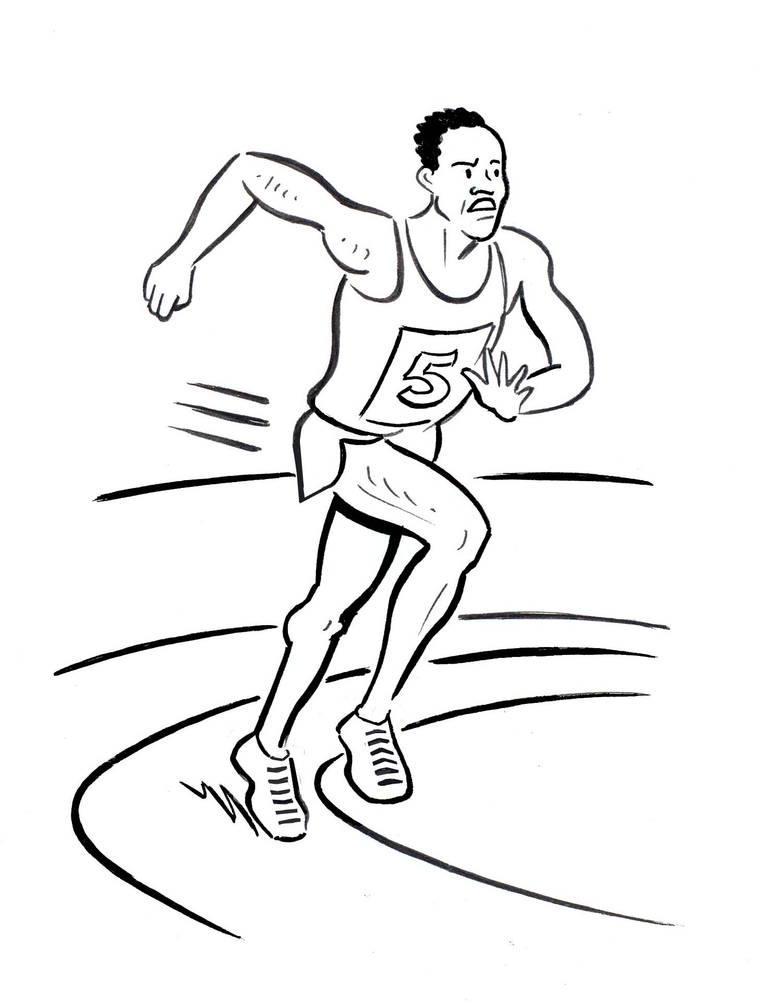
l’athlétisme

Slide 8
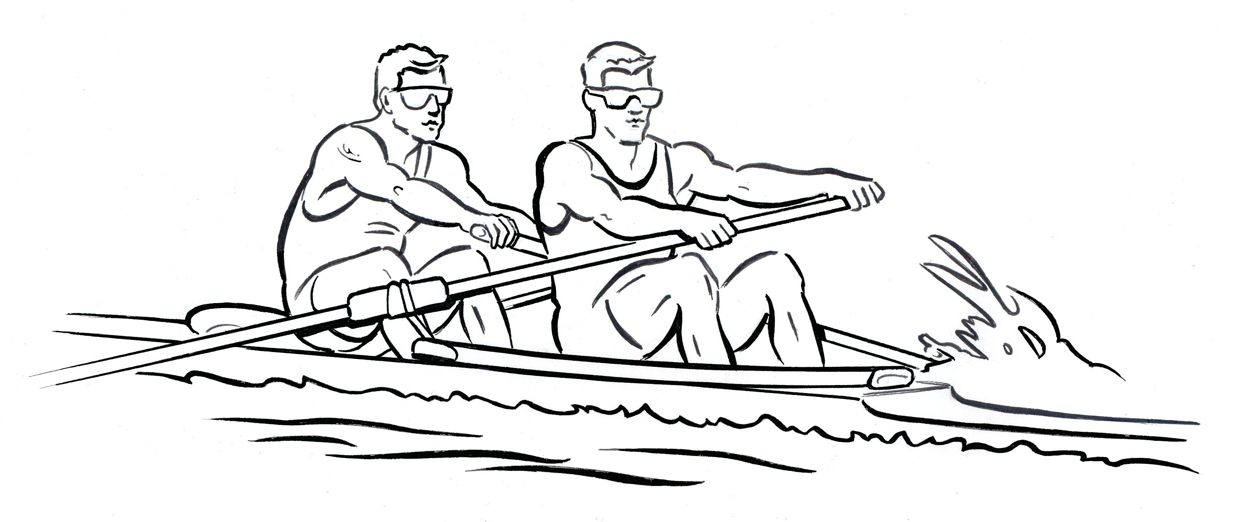
l’aviron

Slide 9
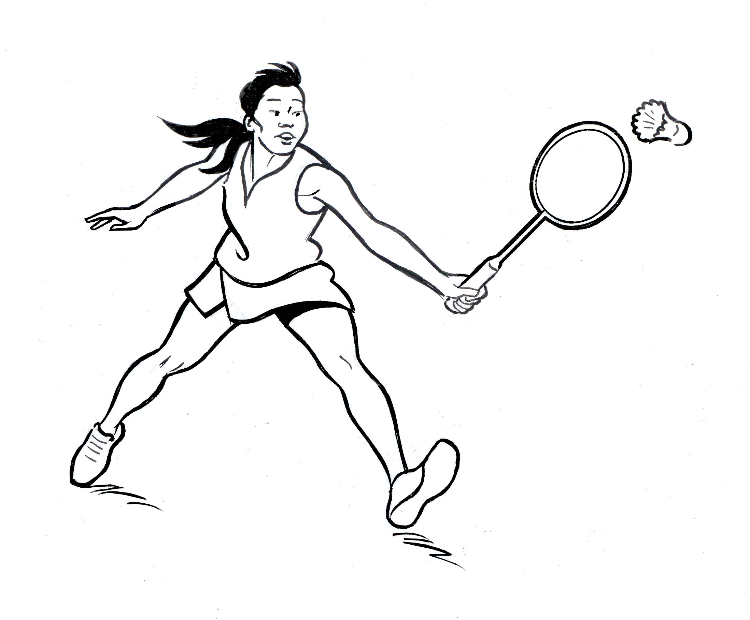
le badminton

Slide 10
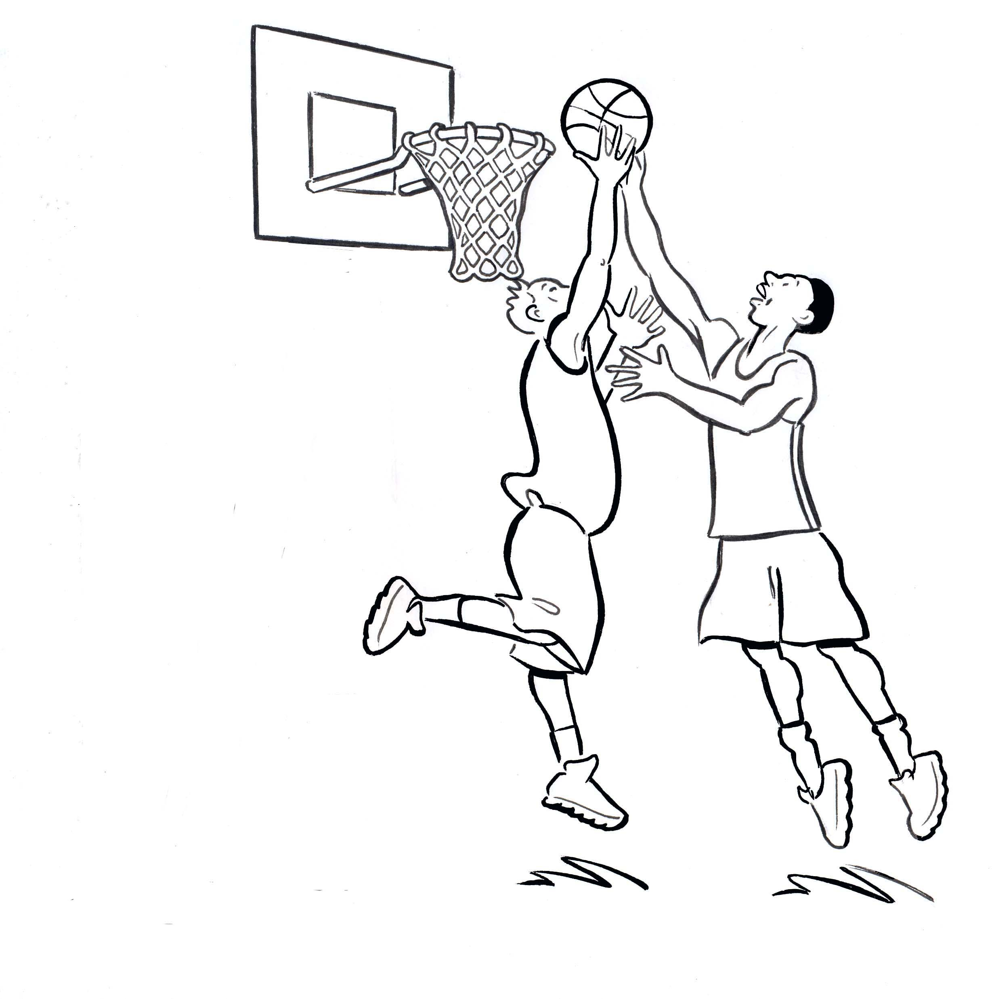
le basketball

Slide 11
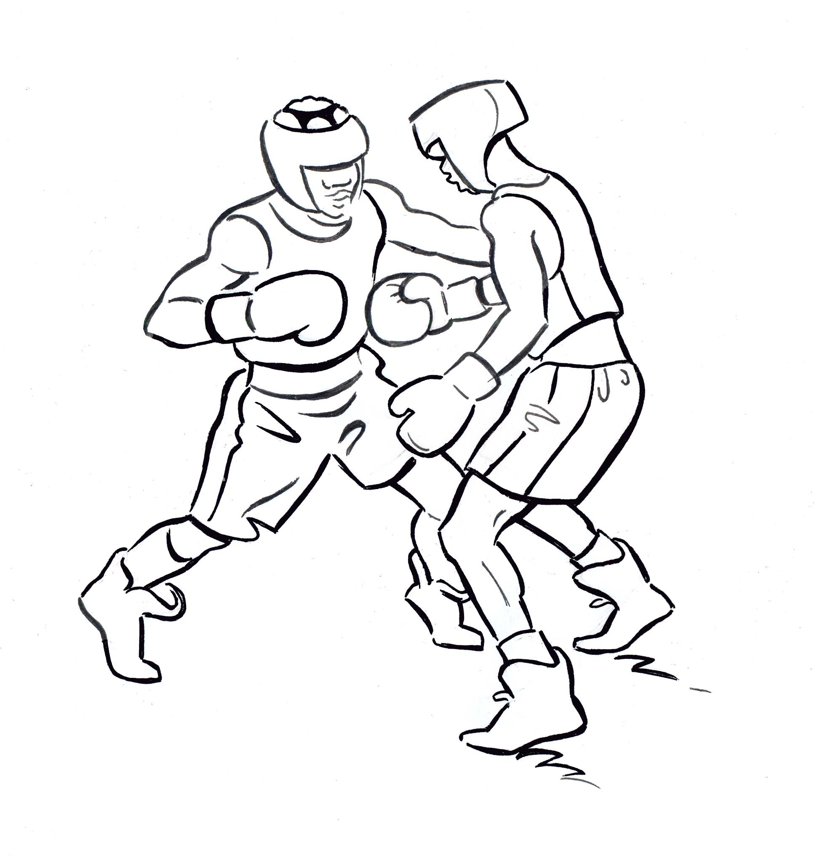
la boxe

Slide 12
le breaking

Slide 13
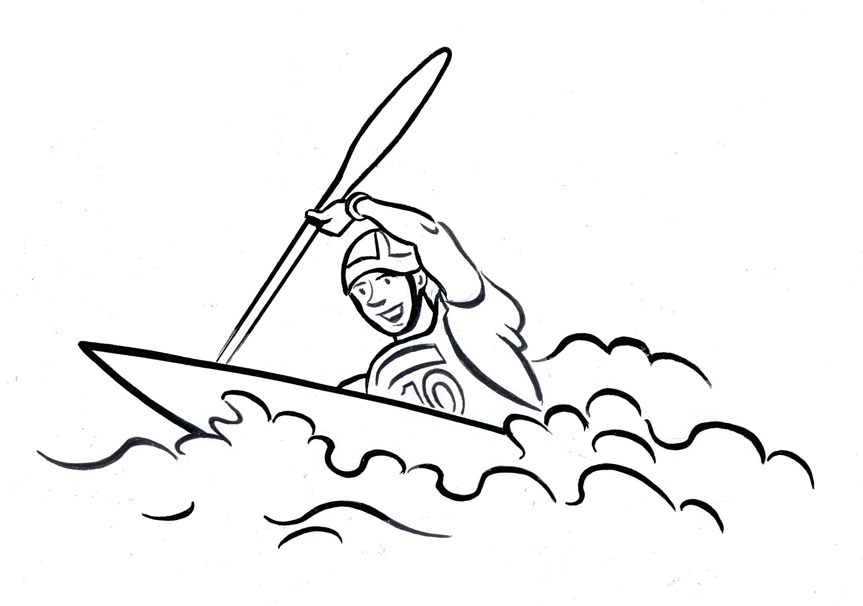
le canoë

Slide 14
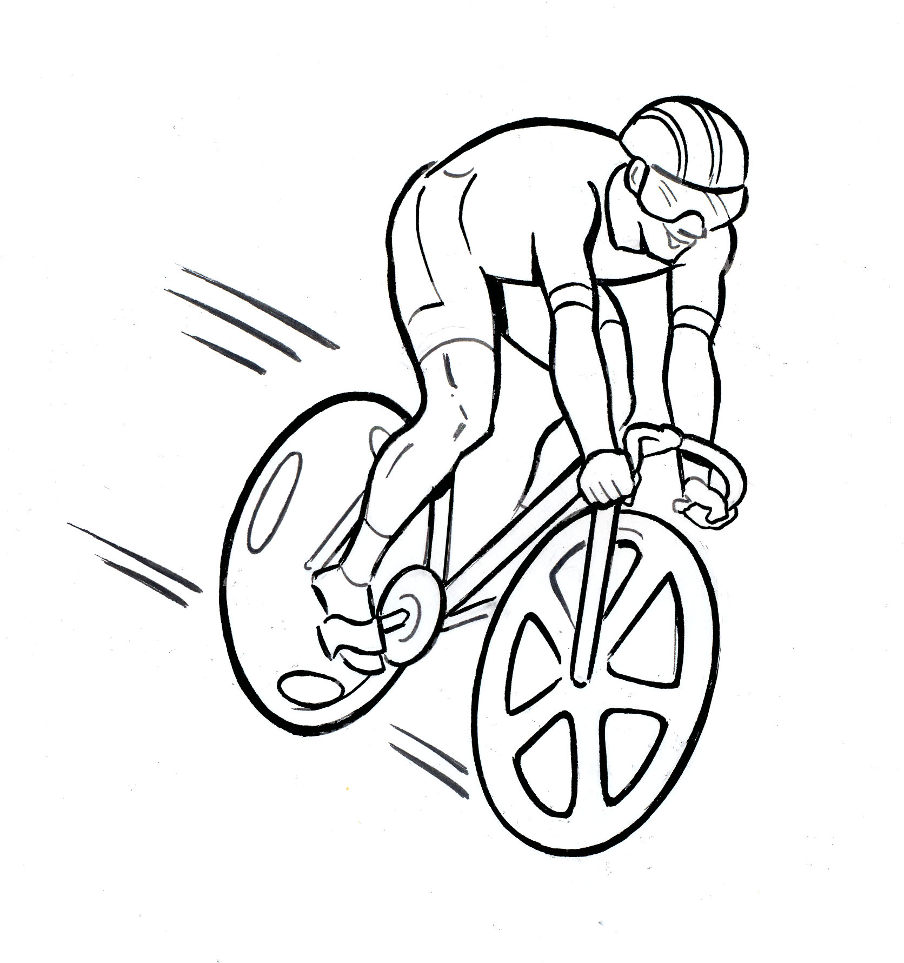
le cyclisme

Slide 15
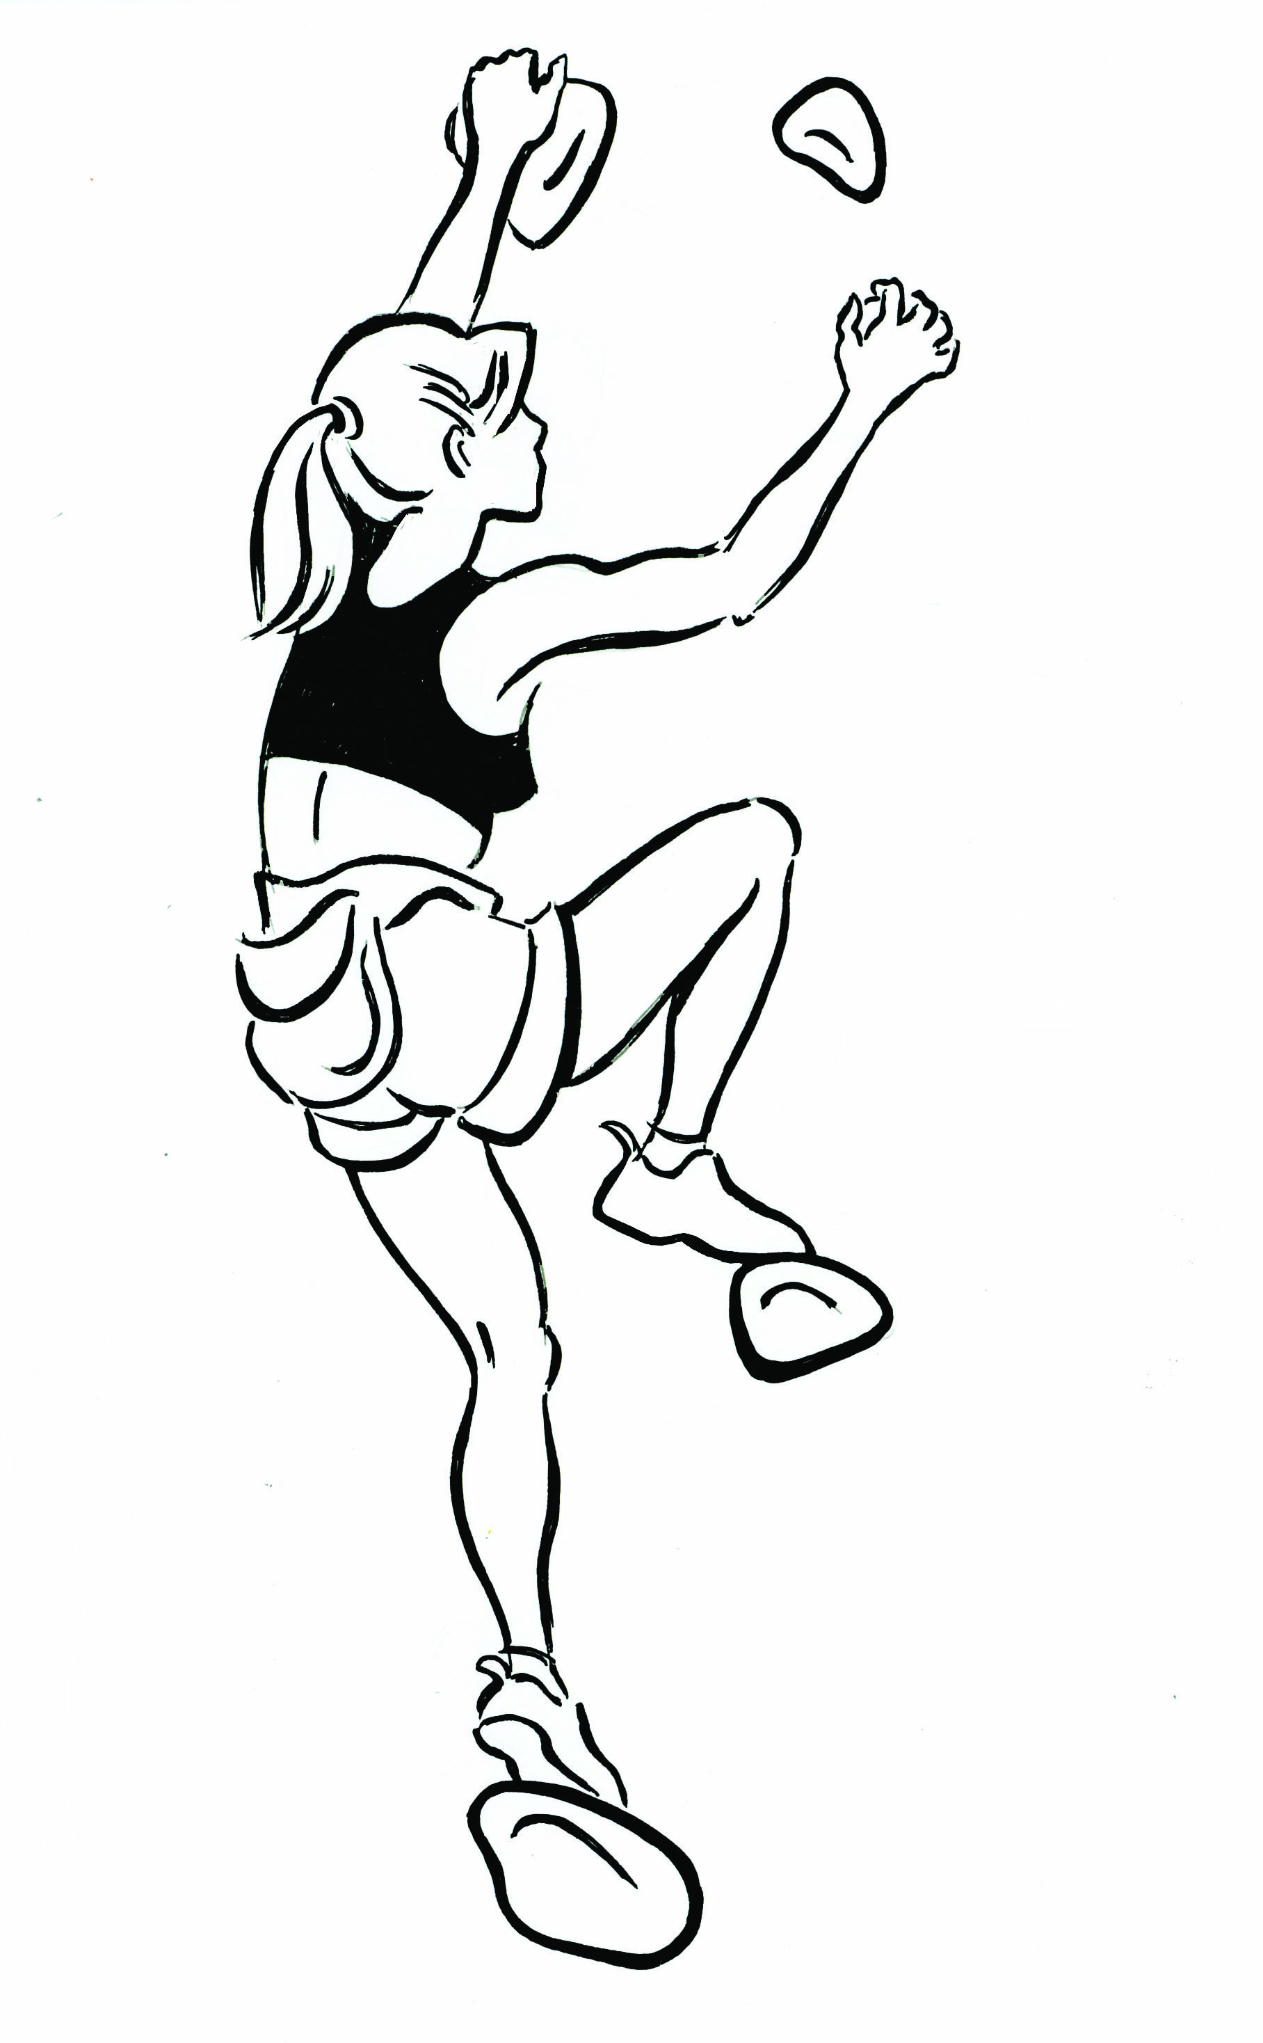
l’escalade sportive

Slide 16
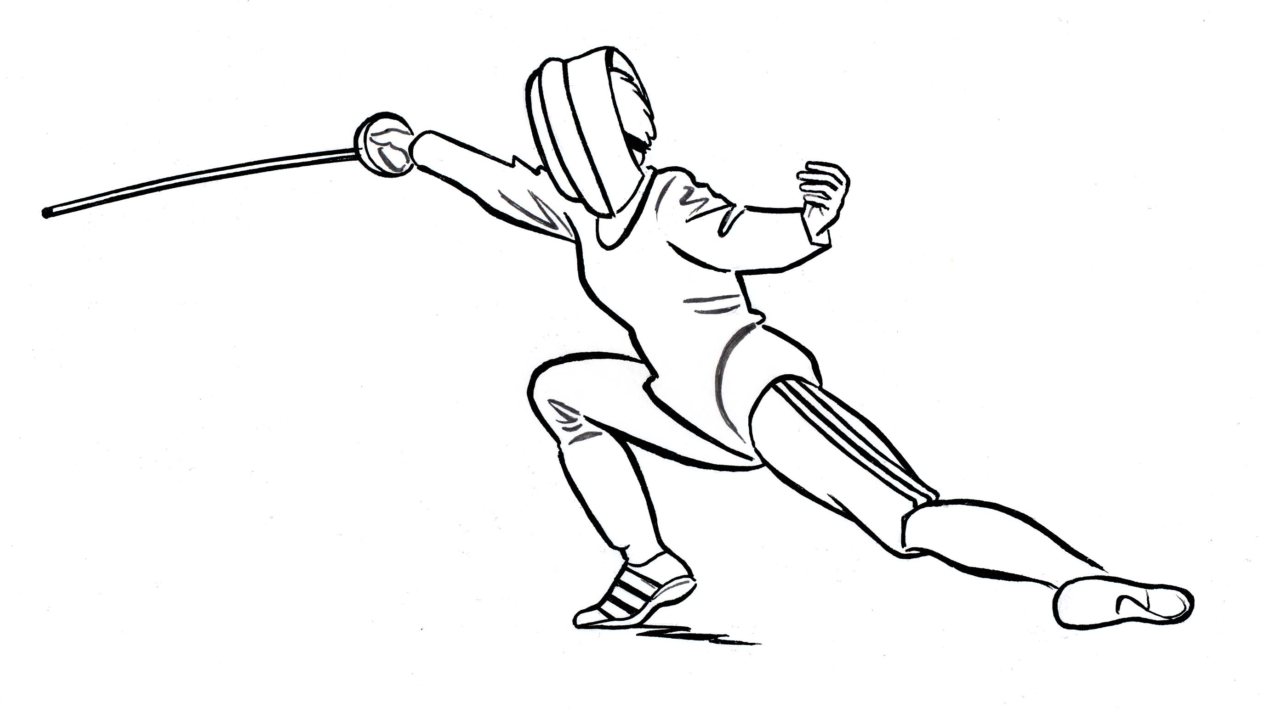
l’escrime

Slide 17
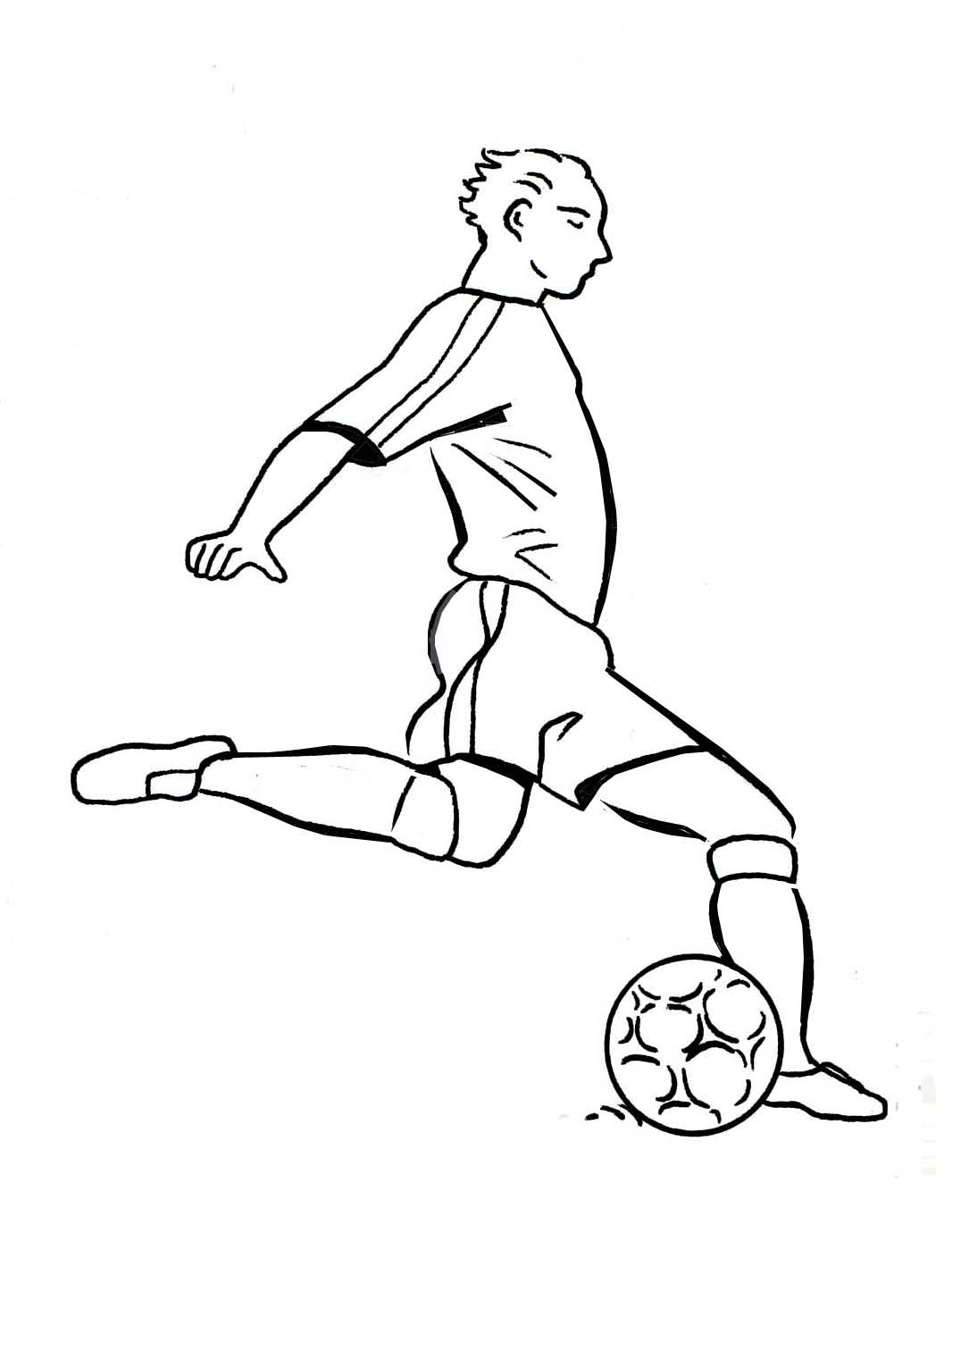
le football

Slide 18
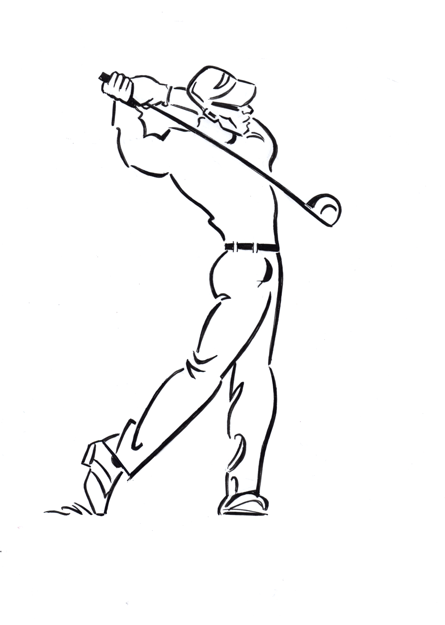
le golf

Slide 19
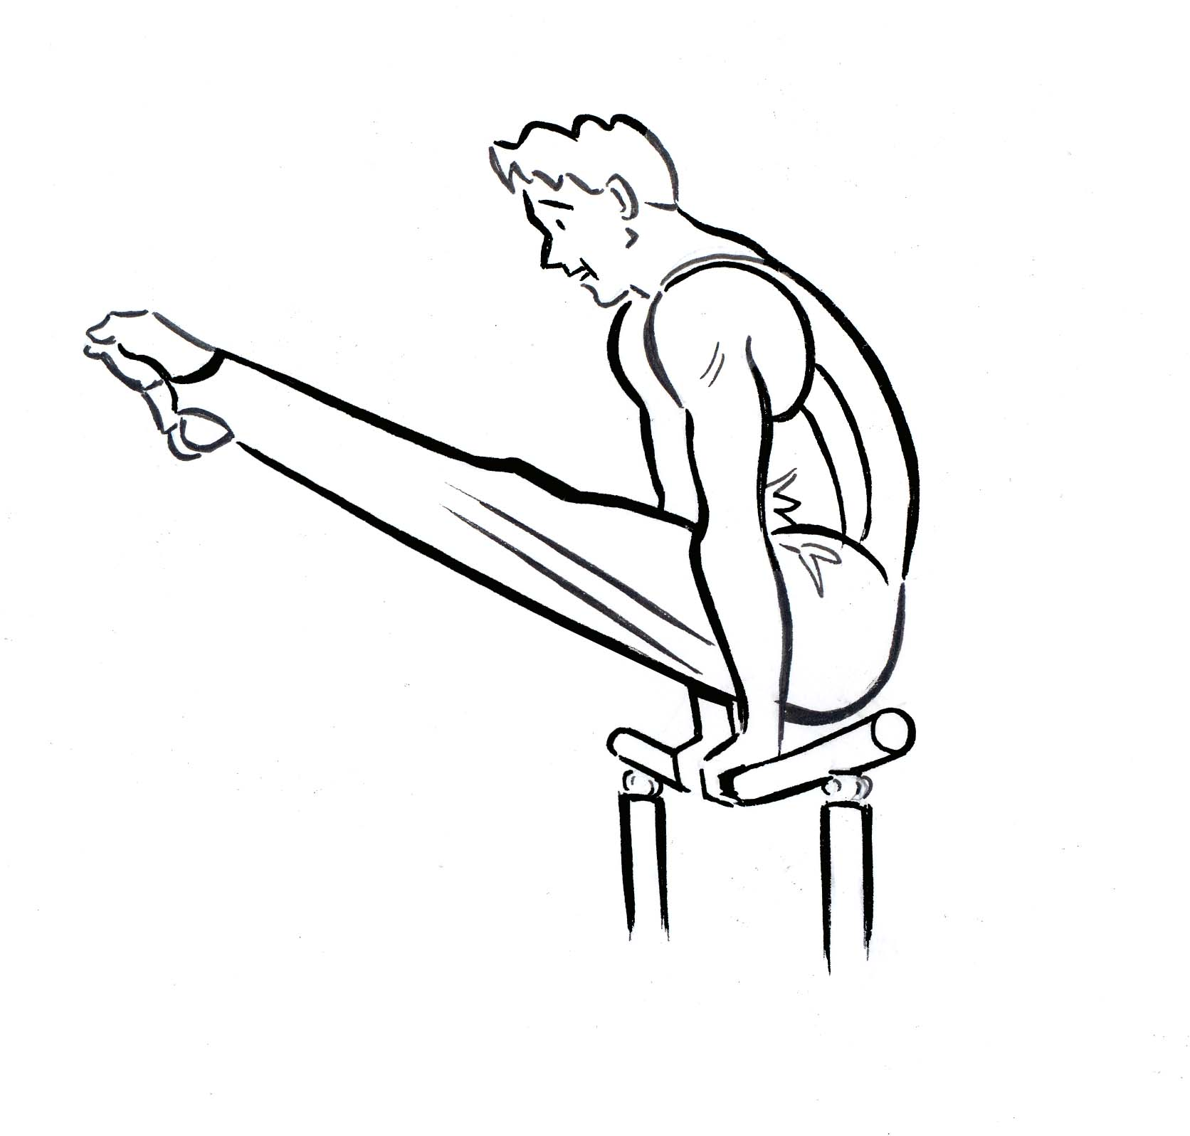
la gymnastique

Slide 20
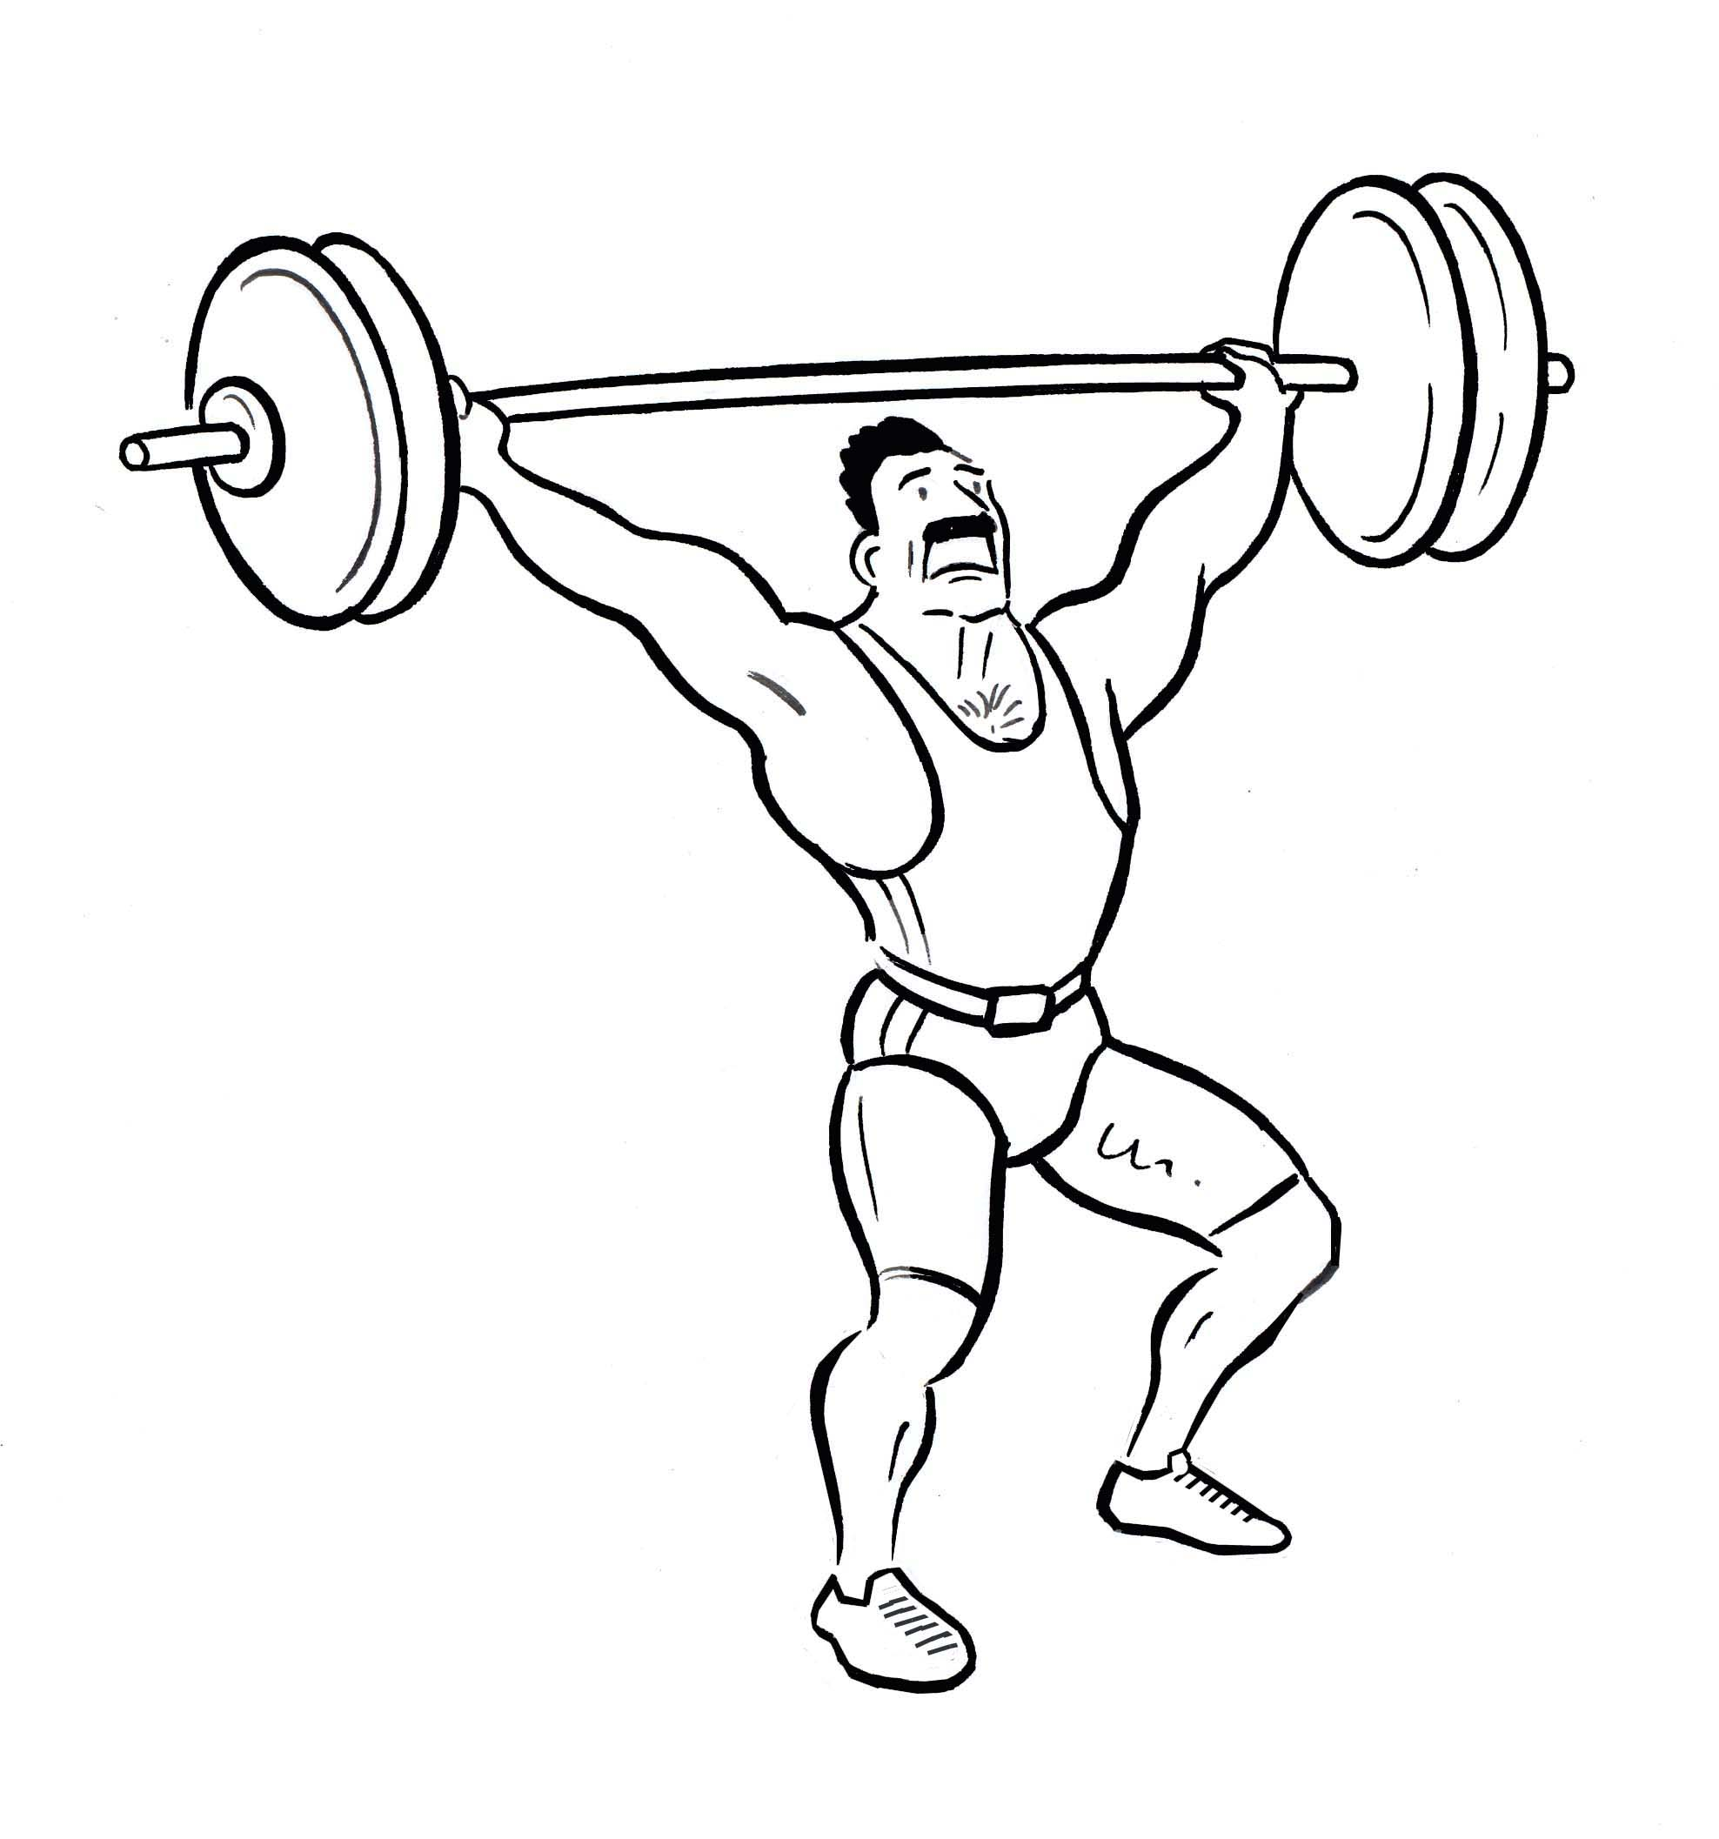
l’haltérophilie

Slide 21
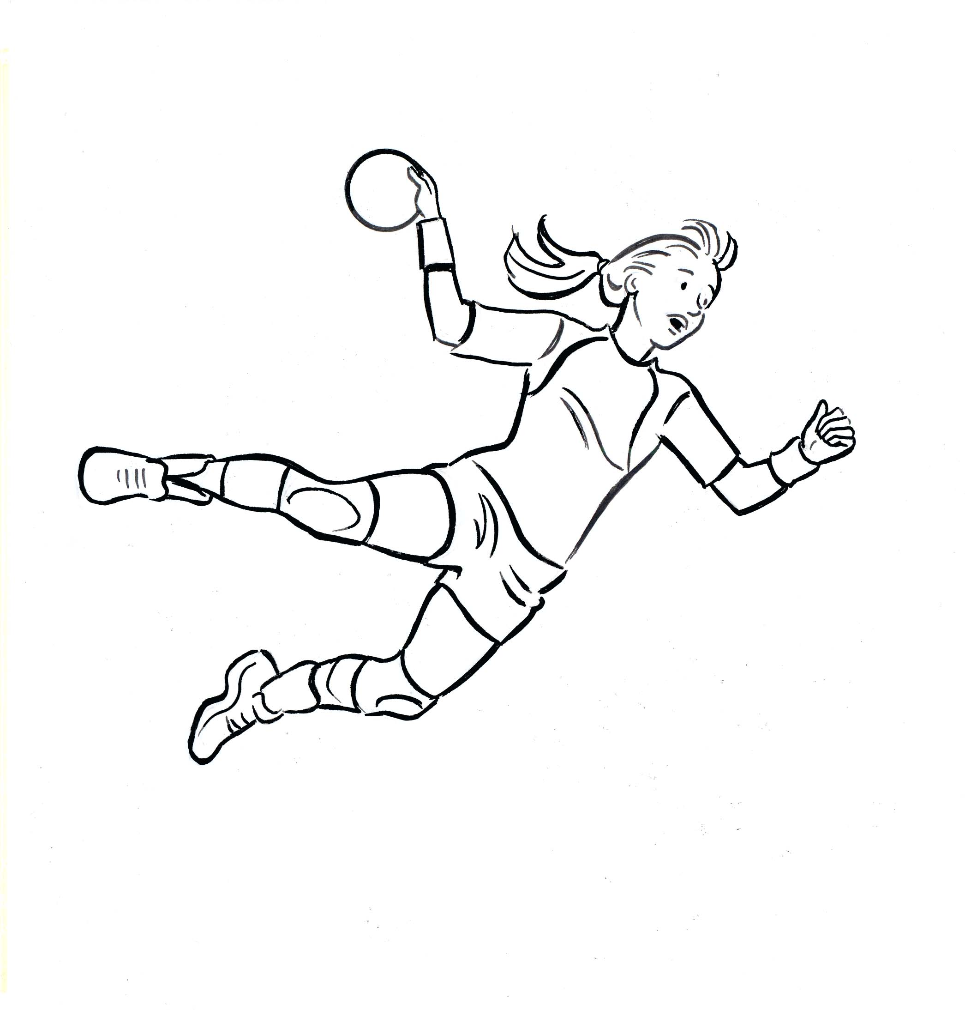
le handball

Slide 22
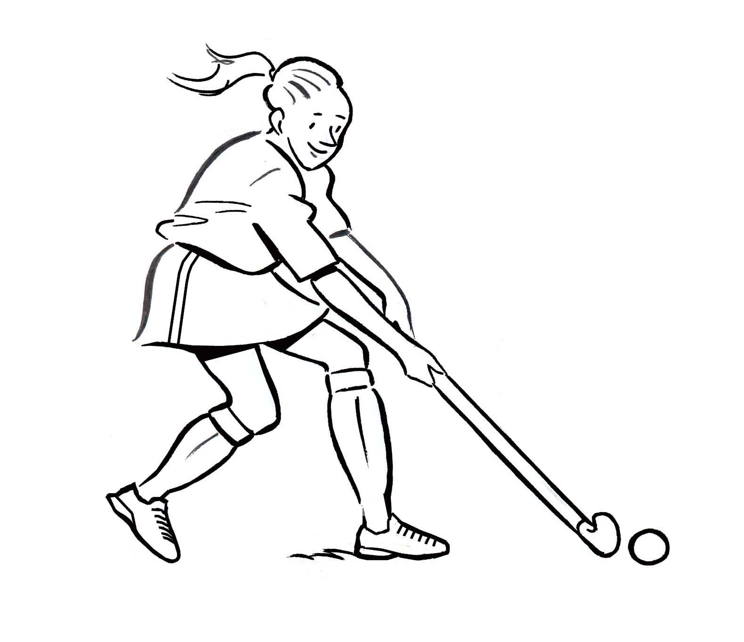
le hockey

Slide 23
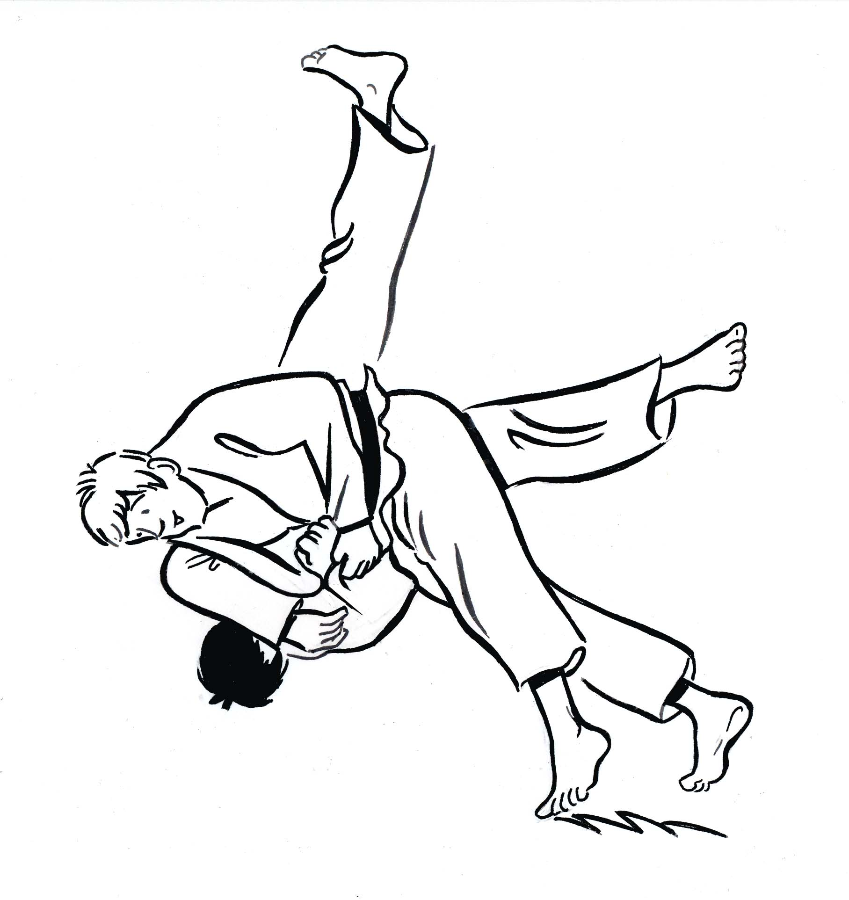
le judo

Slide 24
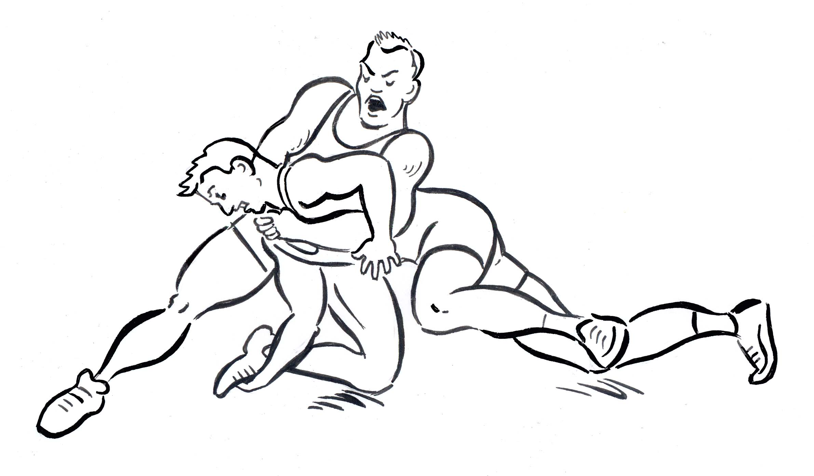
la lutte

Slide 25
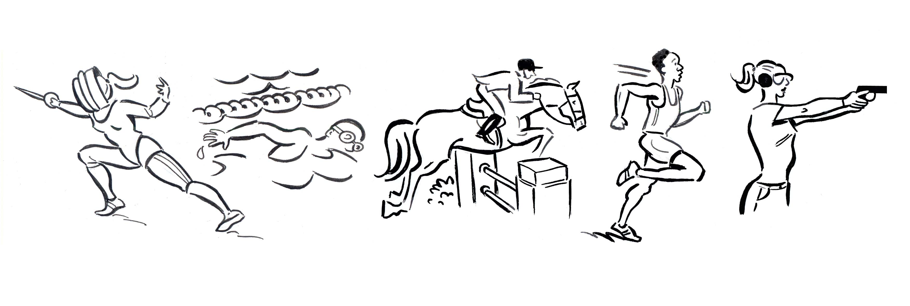
le pentathlon moderne

Slide 26
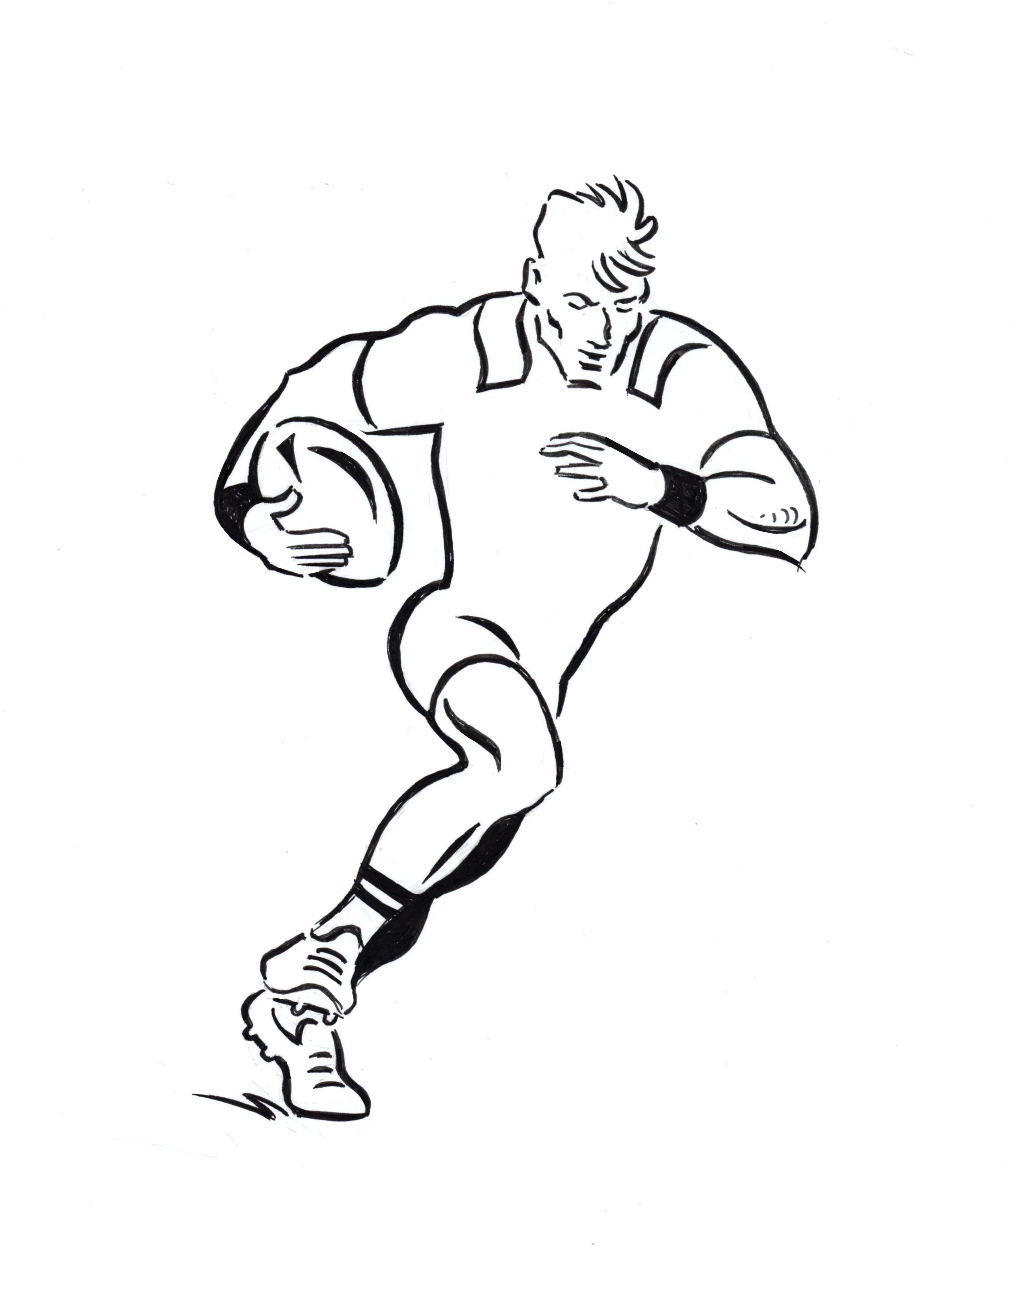
le rugby à sept

Slide 27
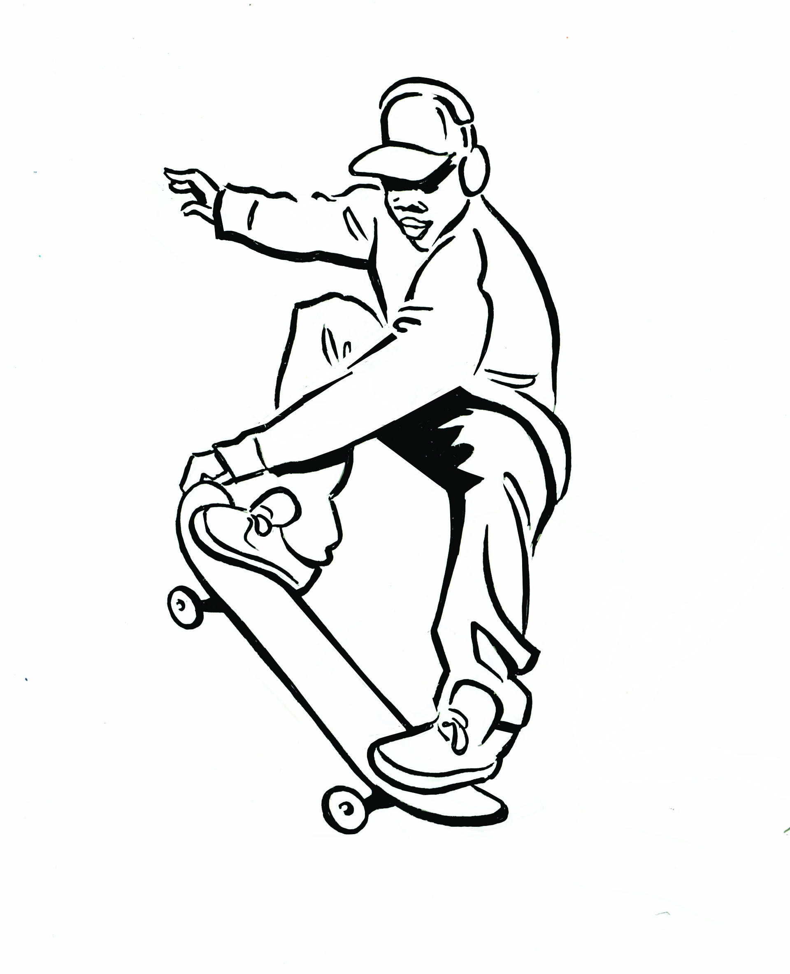
le skateboard

Slide 28
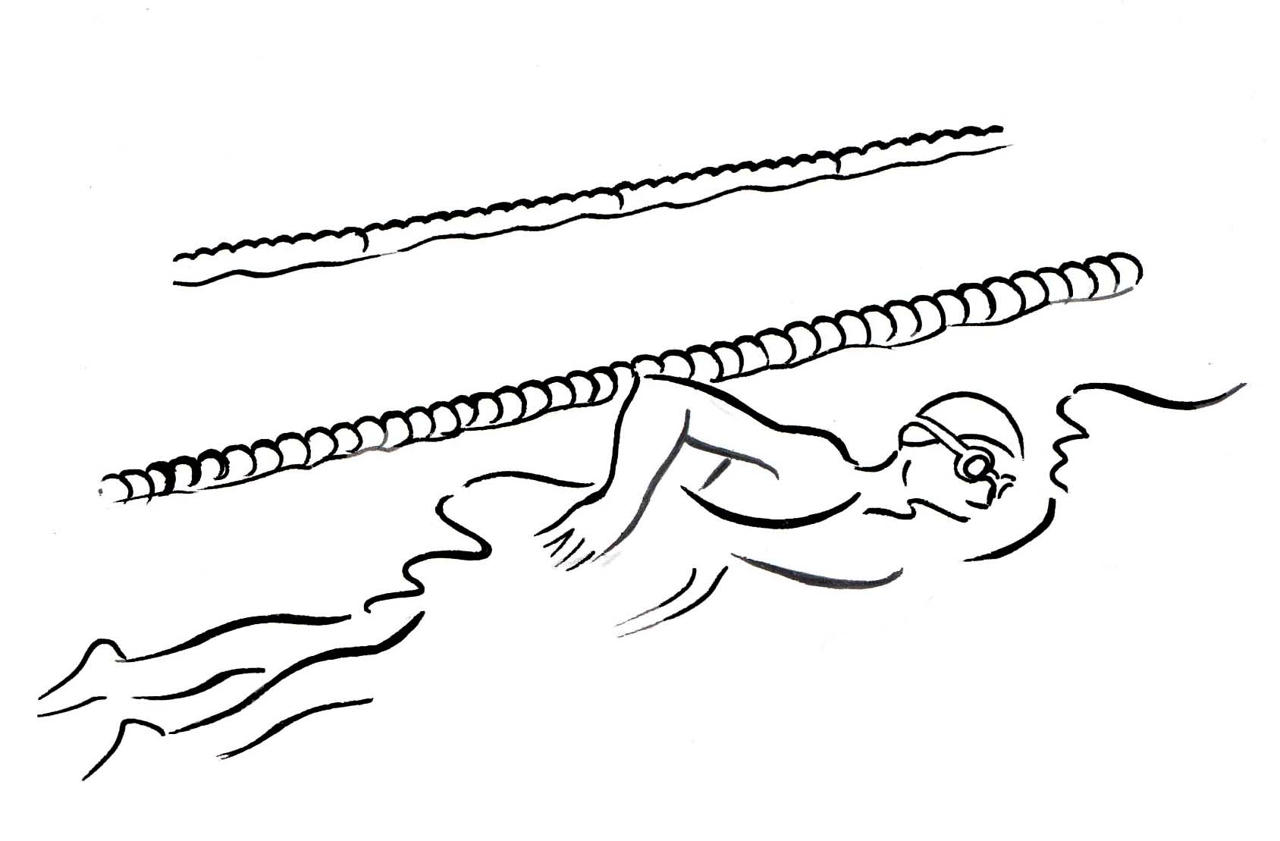
les sports aquatiques

Slide 29
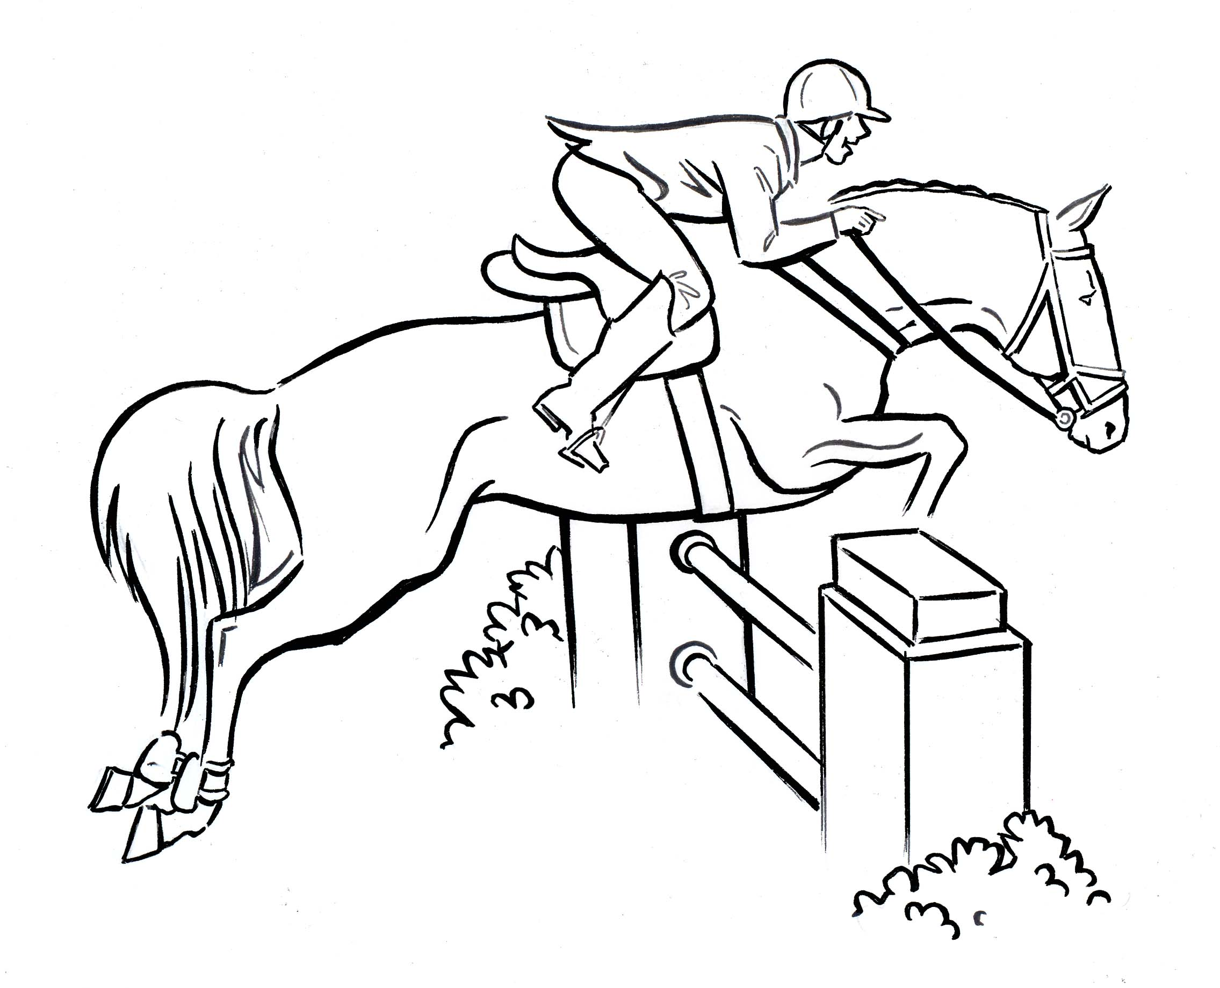
les sports équestres

Slide 30
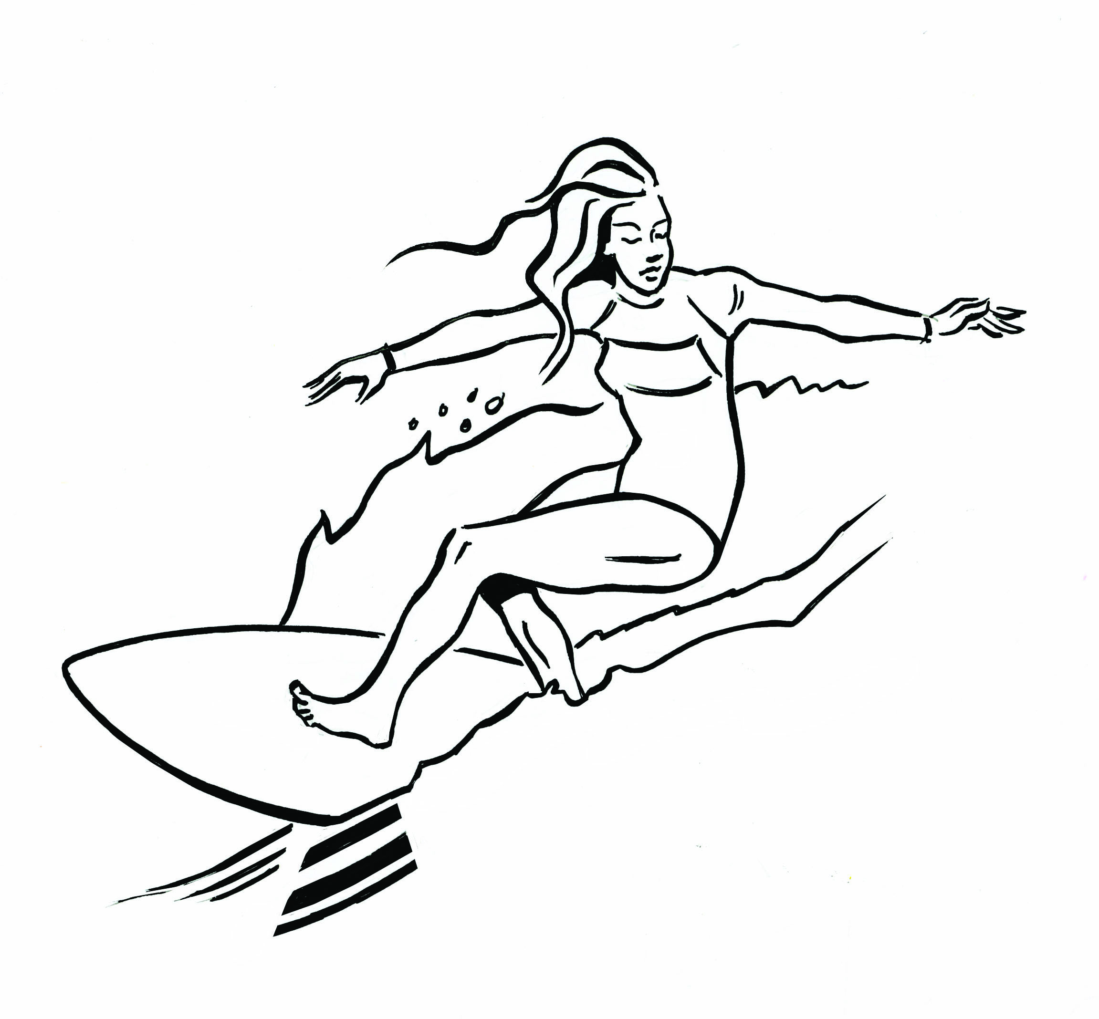
le surf

Slide 31
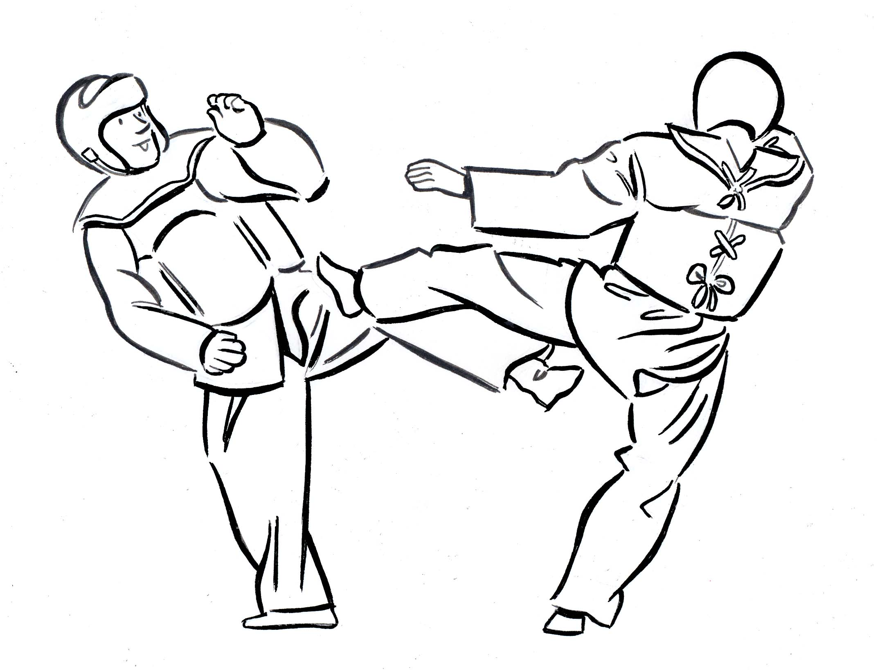
le taekwondo

Slide 32
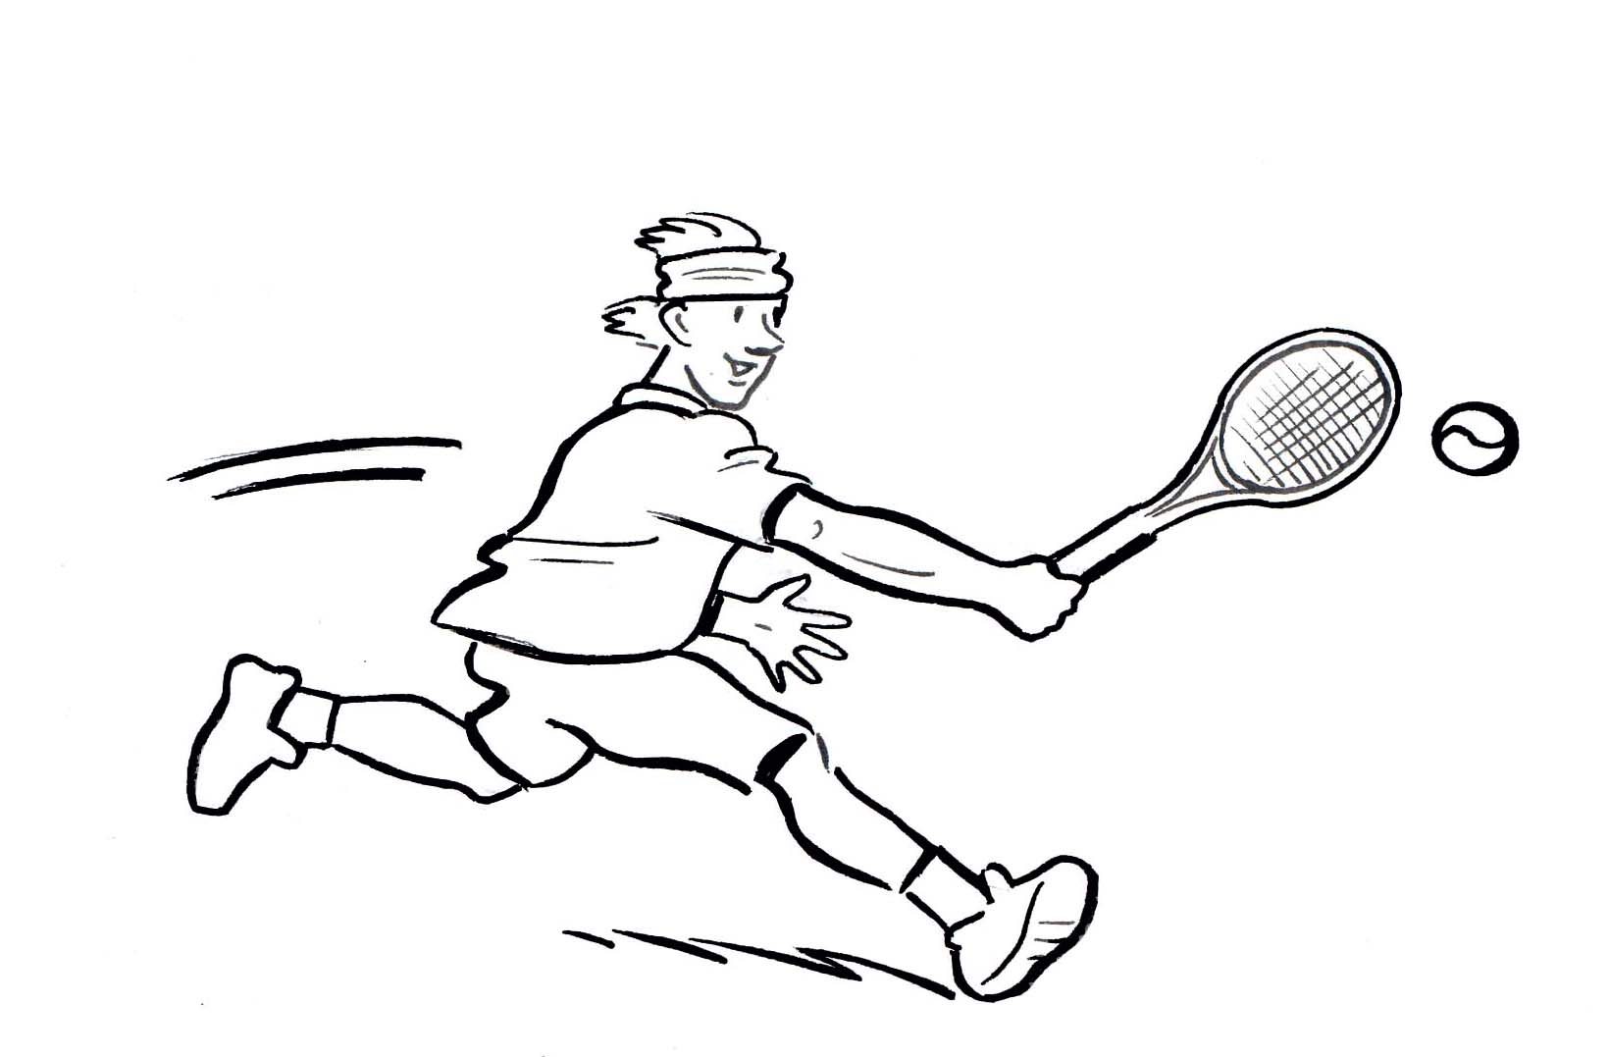
le tennis

Slide 33
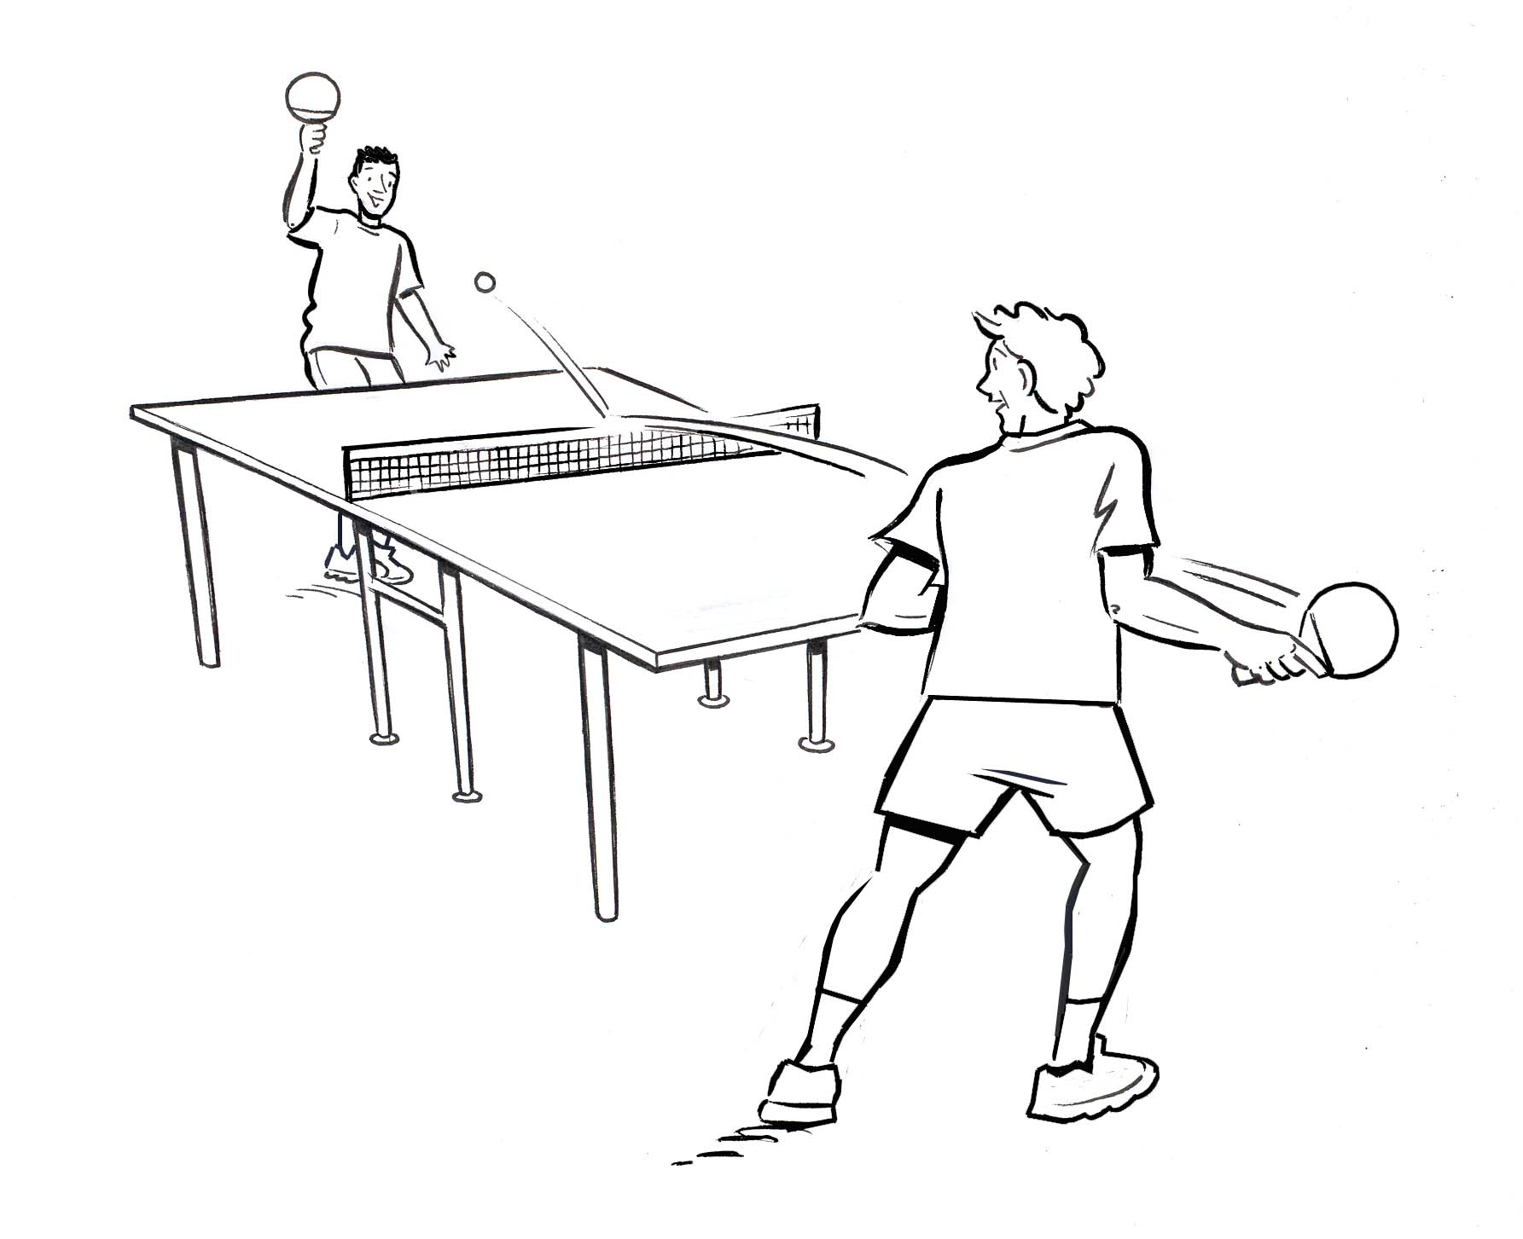
le tennis de table

Slide 34
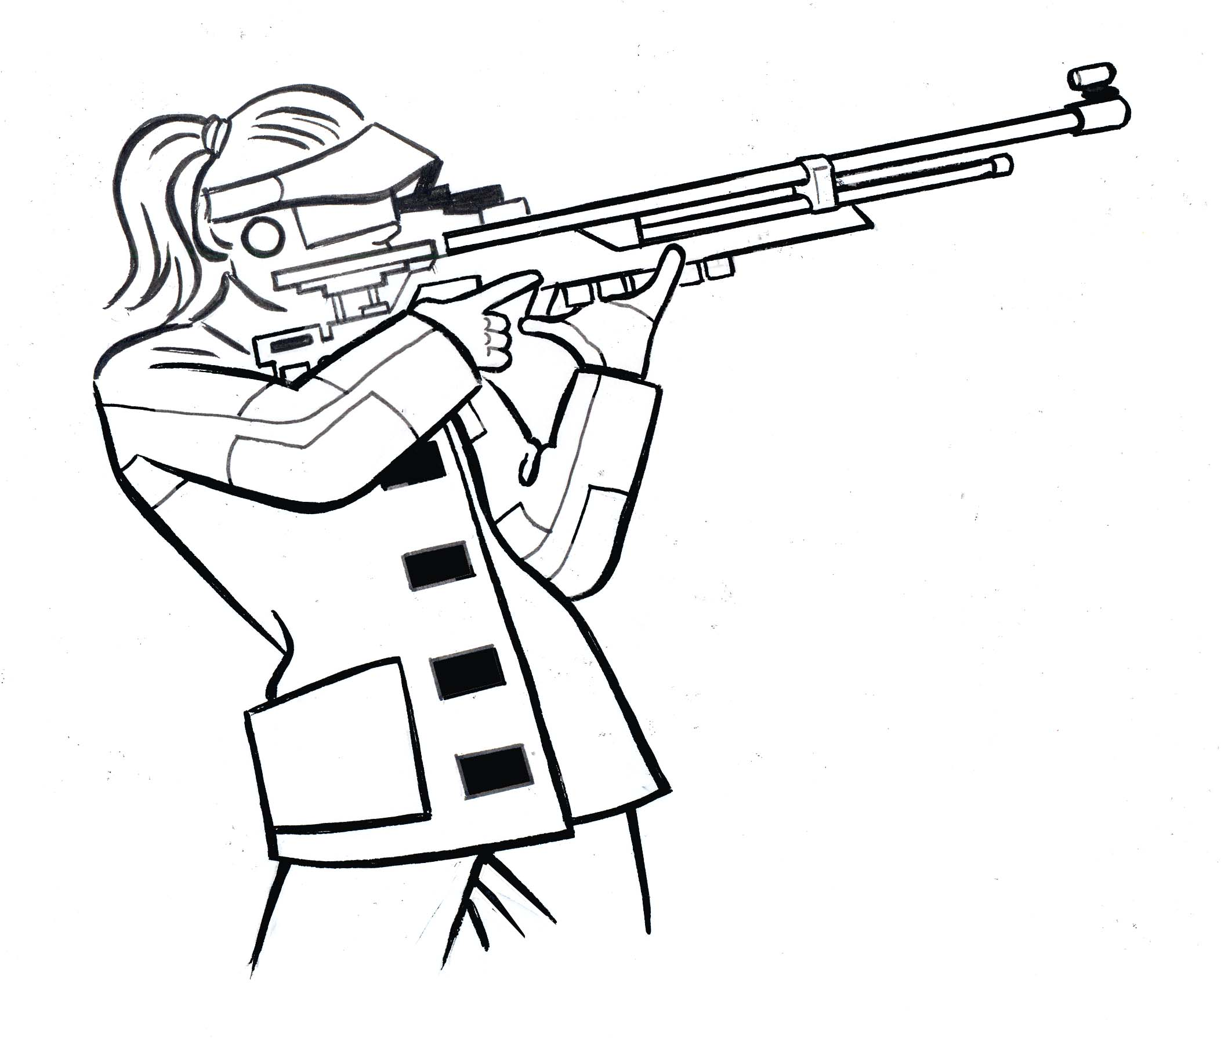
le tir

Slide 35
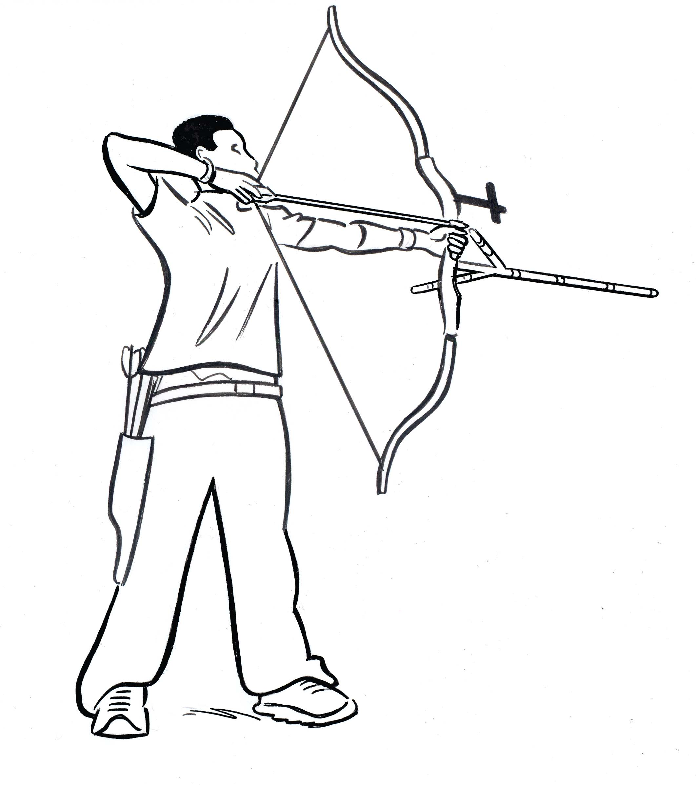
le tir à l’arc

Slide 36

le triathlon

Slide 37
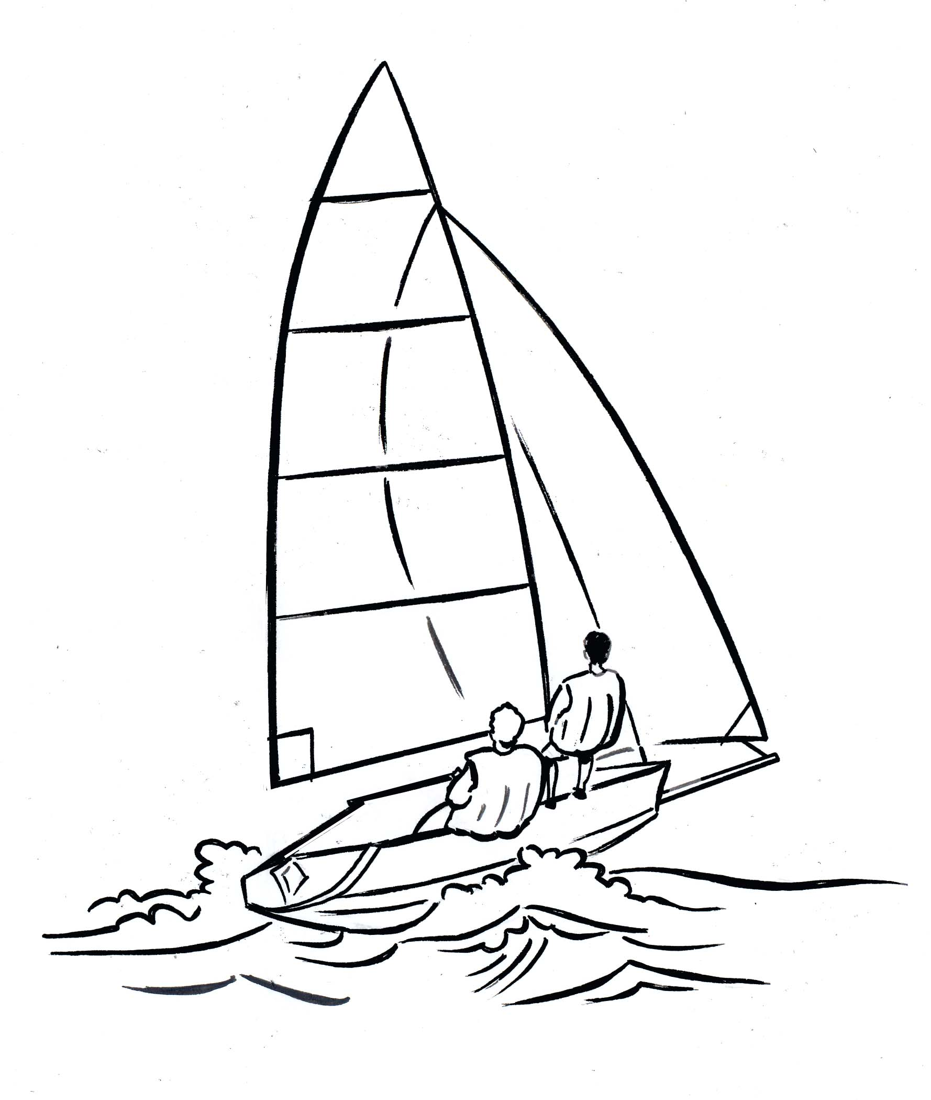
la voile

Slide 38
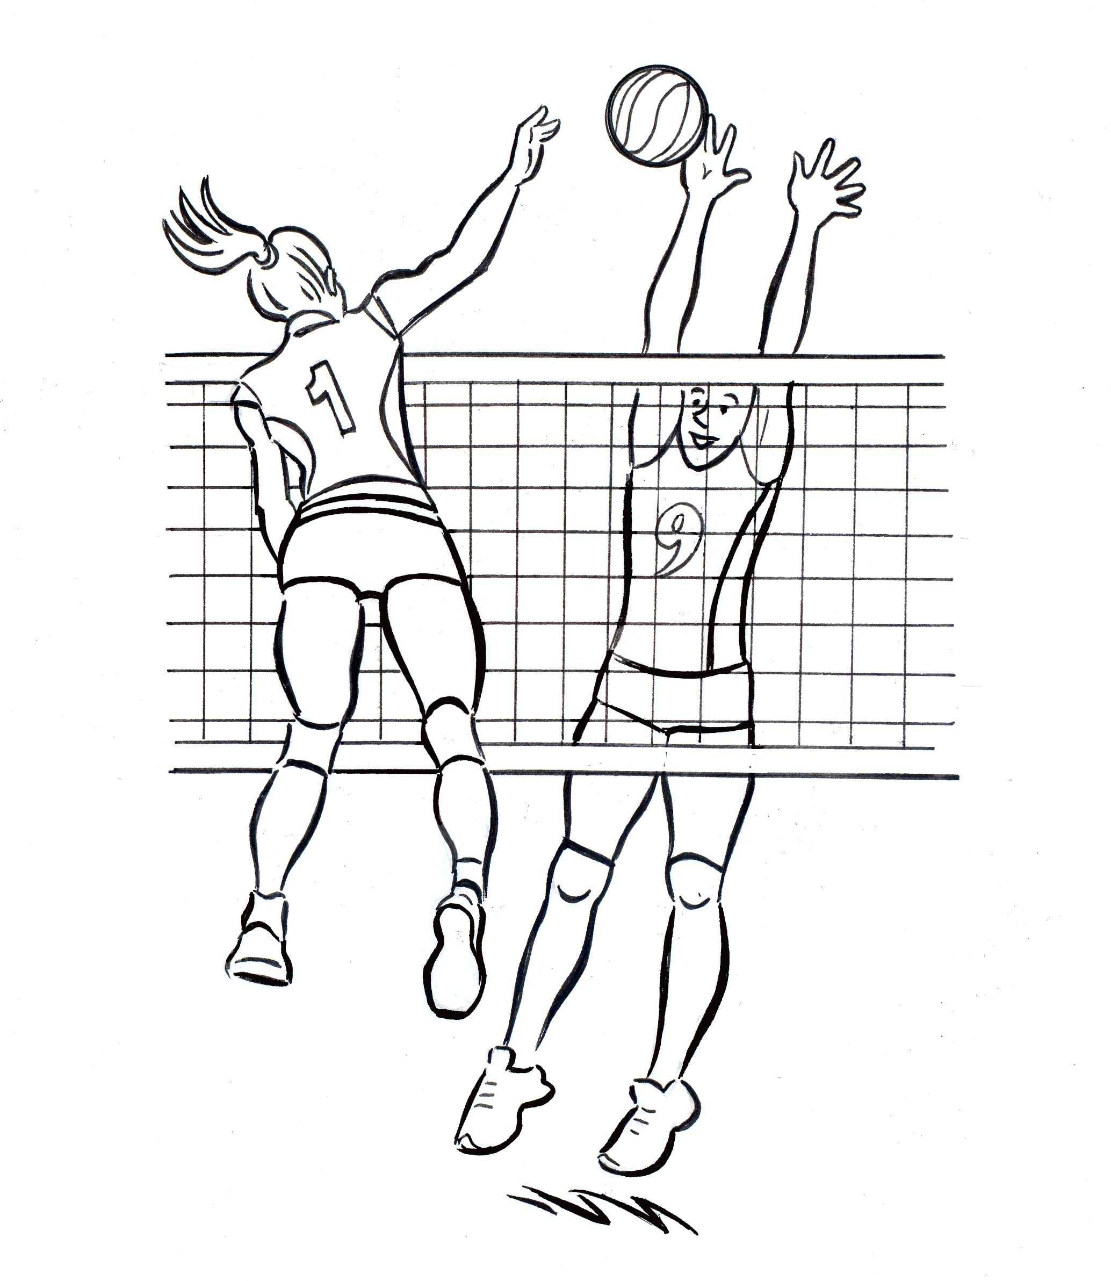
le volleyball

Slide 39

Learn French through the Paris Olympics 2024
Bring the Olympics to life in your French lessons with these engaging and adaptable activities and resources. 2024 is the perfect time for a French topic on ‘les Jeux Olympiques’ as the Games will be held in Paris.
Teach the vocabulary for the 32 Olympic sports through physical activities and games. Then use flashcards, word searches, crossword puzzles and other word games to reinforce the learning. Sentence-building activities, reading passages and surveys make it easy to promote speaking, listening, reading and writing. Pupils will love learning about which sports are the most popular in France, where in France the Games have been held previously and what new sports have been added this year.
For more information: https://brilliantpublications.co.uk/product/teach-french-through-the-paris-olympics-2024/

