Slide 1
Using Songs To Teach French
Catherine Barlow
Author of “Sing and Learn French” and “Let’s Sing French!”
published by Brilliant Publications

Slide 2
Why use songs to teach French?
Who will we use songs with?
What songs will we teach?
How do we teach songs?
How can we exploit songs?
What will our pupils gain from learning songs?

Slide 3
Why use songs to teach French?

Slide 4
To facilitate the learning and memorising of vocabulary and grammar
To enable pupils to pronounce words correctly
To promote cultural awareness and appreciation
To embed French within other areas of the curriculum
Just for fun

Slide 5
Who will we use songs with?

Slide 6
Pupils of all ages and abilities – there are no limits!

Slide 7
What songs
will we teach?

Slide 8
  Songs set to familiar tunes – enable teachers and pupils to focus on lyrics
  Action songs – memory-joggers
  Repetition songs/raps – pupils can copy clearly pronounced lyrics
  Songs made up of lists – aid vocabulary retention
  Traditional French songs – help pupils develop understanding of French culture
  Seasonal songs – Christmas, harvest festival etc

Slide 9
How do we teach songs?

Slide 10
Use existing version of song (CD/You Tube etc) or be prepared to sing a solo!
Allow pupils to listen at least once or twice without joining in
Keep it simple – not too many lyrics
Go over meaning of lyrics/vocabulary – are pupils already familiar with these?
Small sections – repeat words several times
Pronunciation – check pupils copy model carefully
Highlight rhyming words/sound patterns etc
Don’t necessarily show words – it can sometimes hinder pronunciation
Encouragement – some pupils are more reluctant singers – let them join in when they’re ready

Slide 11
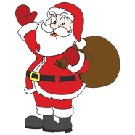
Père Noёl
(Sing to tune of ‘Frère Jacques’)
Père Noёl
Père Noёl
Vite, venez!
Vite, venez!
Apportez des cadeaux
Apportez des cadeaux
S’il vous plaît
S’il vous plaît

Slide 12
How can we exploit the songs?

Slide 13
Phonics – listen and look for sounds/rhymes/cognates
Comprehension – listen for specific vocabulary
Sequencing – pupils put words/pictures/symbols in order as hear them mentioned
Role play – build conversations around a song
Composition – make up extra verses
Festivals/cultural events – incorporate songs into whole school/cross-curricular activities eg assemblies, French Day
Grammar – change structures eg parts of verbs
Cloze tasks – written tasks requiring pupils to insert missing words
Just for fun – to round off a topic

Slide 14
What will our pupils gain from learning songs?

Slide 15
Increased confidence in use of the language
Improved pronunciation
Greater understanding of vocabulary and/or grammatical structures
Awareness of French culture

Slide 16
Les Moyens de Transport
(Sing to the tune of ‘The wheels on the bus’)

Slide 17

Je vais à Paris en avion
En avion, en avion
Je vais à Paris en avion
Toute la journée

Slide 18

Je vais à Paris en voiture
En voiture, en voiture
Je vais à Paris en voiture
Toute la journée

Slide 19
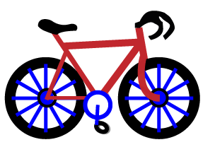
Je vais à Paris à vélo
A vélo, à vélo
Je vais à Paris à vélo
Toute la journée

Slide 20
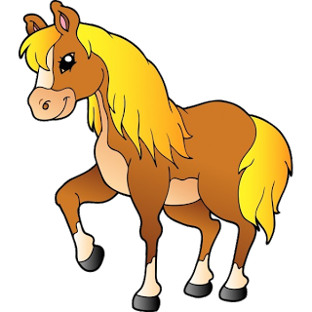
Je vais à Paris à cheval
A cheval, à cheval
Je vais à Paris à cheval
Toute la journée

Slide 21
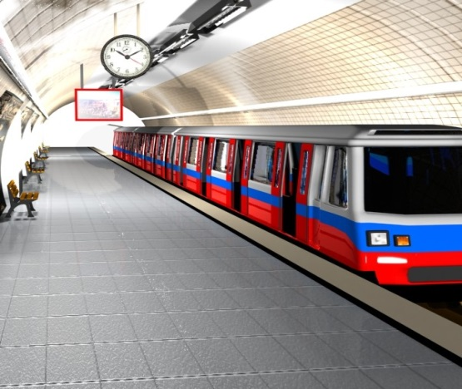
Je vais à Paris en métro
En métro, en métro
Je vais à Paris en métro
Toute la journée

Slide 22

Je vais à Paris en bateau
En bateau, en bateau
Je vais à Paris en bateau
Toute la journée

Slide 23
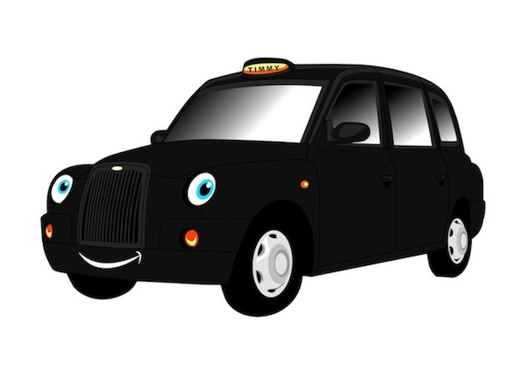
Je vais à Paris en taxi
En taxi, en taxi
Je vais à Paris en taxi
Toute la journée

Slide 24

Je vais à Paris en fusée
En fusée, en fusée
Je vais à Paris en fusée
Toute la journée

Slide 25
Keep it simple!
Make it memorable!
Have fun!

